Slide 1

Self-Regulated Strategy Development in writing
TE 848- 730
Summer 2013
Sarah (Sparks) Bowen

Slide 2

Rationale
National Assessment of Educational Progress Studies Show:
  In 2011, only 27% of 12th grade students achieved a proficient writing score & only 45% of students met the SAT writing benchmark proficiency.
  Only one out of every 5 high school seniors are currently obtaining the required writing knowledge and skills for their grade level
  Only 23% of 4th graders, 26% of 8th graders, and 22% of 12th graders performed at or above grade level in writing
  (Santangelo, Harris, Graham, 2008, Harris, Graham, Mason, 2006, Graham, Harris 2005, Troia, Graham, 2003)

Slide 3
Rationale
Struggling writers tend to have a difficult time:
  Determining what qualifies as good writing
  Utilizing an effective writing approach/following the writing process
  Using graphic organizers/planning out writing assignments and providing enough details on their plan
  Spending a sufficient amount of time on the revising process
  Summarizing information
  Transferring ideas between drafts /transcription skills
Struggling writers often focus simply on producing content known as “knowledge-telling.”
(Santangelo, Harris, Graham, 2008, Graham, McArthur, Fitzgerald , 2007, Frey, Fisher, Hernandez, 2003)

Slide 4
What is SRSD?
SRSD is “ a writing strategies instruction approach developed over the past 2 decades which brings together powerful strategies for writing and critical strategies for self-regulation of the writing process, has been used in the elementary through high school grades” (Harris et. al, 2008).
Process of goal setting and improving students’ writing skills (Schunk, 1990)
“The ultimate goal of SRSD is to have students successfully apply strategies over time and in new situations” (Santangelo, Harris, & Graham, S 2008)
Based on 6 principles:
Develop background knowledge
Discuss it!
Model it!
Memorize it!
Support it!
Independent performance
(Graham, McArthur, & Fitzgerald , 2007, Harris et. al, 2008, Graham, Harris, McArthur, 2006)

Slide 5

SRSD VS. Writers Workshop?
Similarities:
  Emphasis on the writing process
  Practice frequent writing
  Encourage student decision making and interactions with peers
  Share work with teacher and peers
Differences:
  SRSD is more explicit, systematic, and lengthier process. Focuses more on the written project with less drafting stages.
  Writers’ workshop is a more student-centered approach than SRSD with multiple drafts
  “In comparison with children in the Writers’ Workshop condition, SRSD-instructed students were more knowledgeable about writing and evidenced stronger performance in the two instructed genres (story and persuasive writing) as well as two uninstructed genres (personal narrative and informative writing)” (Harris, Graham, Mason, 2006)
  (Harris, Graham, Mason, 2006, Lienermann, Reid, 2006)

Slide 6

Review of research
Over 40 studies have been conducted which show how SRSD increases students:
  Ability to brainstorm and organize their ideas
  Quality of writing
  Ability to edit and revise their work
  Motivation/level of engagement
  Ability to self-regulate and monitor their own writing progress through goal setting
(Santangelo, Harris, Graham, 2008 , Harris et. al, 2008, Harris, Graham, Mason, 2006, Troia, Graham, 2003)
    “Helps students gain greater awareness of their writing strengths and limitations and consequently be more strategic in their attempts to accomplish writing tasks” (Troia, Graham, 2003)

Slide 7

Review of Research cont.
Developed to build students behavior, knowledge, and motivation towards writing.
Instruction is targeted towards building students planning, writing, and persuasive essay skills.
Helps students monitor their own writing.
Students learn goal setting, self monitoring, and self instruction
(Harris, K., Graham, S., & Mason, L, 2006, Troia, G., & Graham, S. 2003)

Slide 8

SRSD Principals
Discuss background knowledge
  Provide written examples of the new genre (ex: stories, essays) to build students’ vocabulary
Discuss it
  Introduce graphing/self-monitoring/self-regulation skills.
  Discuss importance of planning, (ex: use chart paper to discuss writing steps).
Model it
  Think aloud strategy to discuss how to write in particular genre
  “the teacher models how to use the target strategy and then provides students with as much support as they need as they progress toward independent use of the strategy. (Troia, Graham 2002)
  Also important to model self-regulation and behavior students might display during writing
        http://www.youtube.com/watch?v=czNaUbeAZnA (skip forward to 2:43 – 3:38)
(Graham, Harris, McArthur, 2006, Harris et. al, 2008, Santangelo, Harris, & Graham, 2008, Lienermann, Reid 2006, Harris, Graham, Mason 2006)

Slide 9

SRSD Principals cont.
Memorize it
  Homework- memorize the steps, explain steps and use mnemonics/songs
Support it
  Collaborate with struggling students
  Reflect on initial goals to determine if students’ mastered goals
Independent performance
  Struggling learners will take more time/require more guidance on this step during the first writing assignment of the new genre
  For those students who have mastered this step students can revise their work to meet goals.
Teacher modeling the steps of SRSD (Additional Resource): http://www.youtube.com/watch?v=4-zVG38kBcU
(Graham, Harris, McArthur, 2006, Harris et. al, 2008, Santangelo, Harris, & Graham, 2008, Lienermann, Reid 2006, Harris, Graham, Mason 2006)

Slide 10
Self-Regulation Techniques
Self-observation, Self-judgment, Self-reaction, Self-reinforcement
Goal Setting Increases Students:
  Motivation
  Expectations about an assignment
  Encourages students to plan out assignments
  Self- observation/ self-monitoring by comparing their work to rubrics and goals
(Schunk, 1990, Santangelo, Harris, & Graham, S 2008)
Goal Setting
Self-regulation
Self-observation
Self-judgment
Self-reaction
Self-efficacy

Slide 11

How to monitor and evaluate srsd?
Collaborative between teacher & student
Make it multidimensional
  Evaluate if students are beginning to spend more time on the writing process
  Evaluate if their motivation and perception of the writing process has changed
On-going and continuous evaluations
  Helps monitor struggling students
  Allows teachers to reflect after each lesson
Focus on how students use each strategy
(Santangelo, Harris, & Graham, S 2008)

Slide 12
Planning Strategy during srsd
“Planning is an essential ingredient in skilled writing; skilled writers spend a considerable amount of time planning what to do and say, including setting goals, generating ideas, and organizing ideas into writing plans” (Graham, Harris, 2003)
Struggling writers know less about the strategies/processes for planning an essay. They also do minimal planning if they view the task as difficult.
  “For example, Englert, Raphael, Fear, and Anderson found that poor writers were less knowledgeable than writers about how to develop and organize ideas for writing a paper. (Harris, Graham, Mason 2006)
POW mnemonic :
    (Harris, Graham, Mason, 2006, Harris, et. Al 2008)
P=Pick my idea
O=Organize my notes
W=Write and say more

Slide 13
Mnemonics For Story Writing
POW+ ….
WWW,
What =2
How=2
C-SPACE
(Harris et. Al 2008, Lienermann, T., & Reid, R. 2006)
W= Who is the main character?
W= When does the story take place?
W= Where does the story take place?
W= What does the main character do or want
to do; what do other characters do?
W= What happens then? What happens with
the other characters?
H= How does the story end?
H= How does the main character feel; how do the other characters feel?
C= Characters S= Setting P= Purpose A= Action C=Conclusion E= Emotions

Slide 14
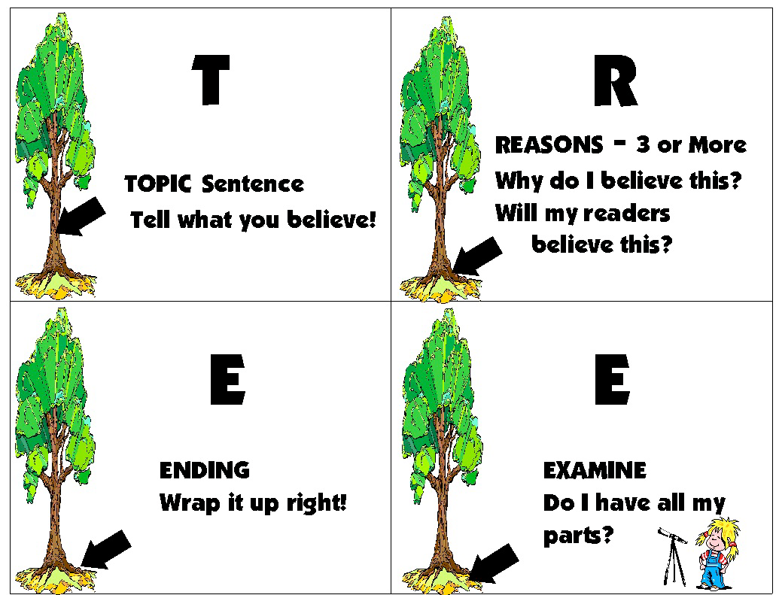
SRSD Mnemonics for Narrative, Expository, & Persuasive Writing
POW + ….
TREE
  T= Topic Sentence
  R= Reasons
  E= Ending/Explain
  Reasons
  E= Examine/Ending
  Additional Example:
  http://www.youtube.com/watch?v=GUchFnOBArs
                (Harris et. al 2008, Project Write, 2009)

Slide 15
(Project Write, 2009)

Slide 16
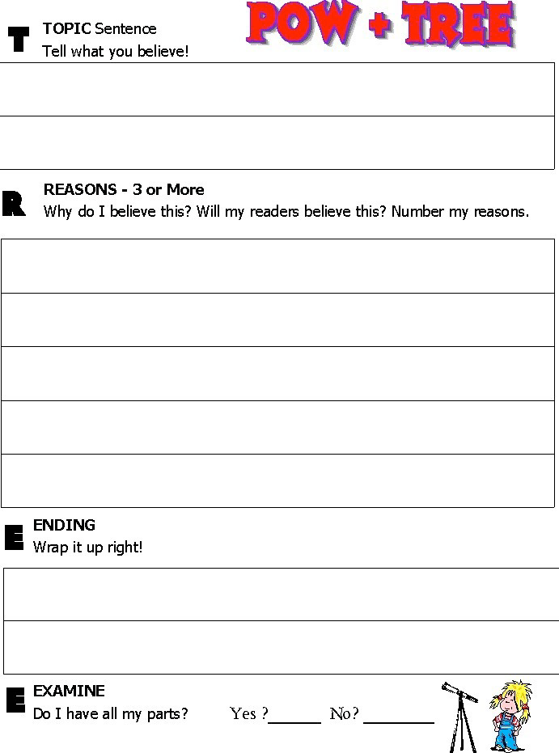
(Project Write, 2009)

Slide 17
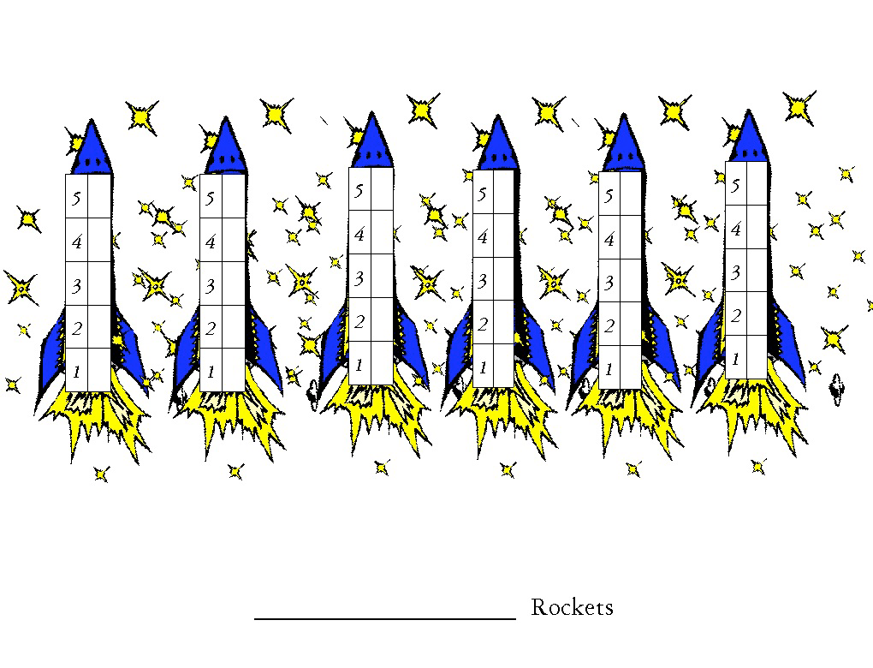
Self-Monitoring during tree
(Project Write, 2009)

Slide 18
(Project Write, 2009)

Slide 19

Persuasive Writing- STOP
Reminds students to plan before writing
Suspend Judgment
  Have students consider both sides of the position.
  Encourage them to brainstorm ideas making a t-chart
Take a Side
  Have the students read their ideas to determine which side they agree with
Organize Ideas
  Pick strong ideas by having students put a star/mark next to the ideas they want to use in their piece.
  Have the students pick __ arguments from the other side of the chart which they want to contradict.
Plan More as you Write
  Have the students continue to write by using AIMS/DARE
        (Harris et. al 2008, Kiuhara et. al 2012)

Slide 20
Persuasive Writing- AIMS & DARE
Helps students organize and write their essay
  A= Attract the reader's attention
  I= Identify the problem of the topic so the reader understands the issues,
  M= Map the context of the problem/ provide background information
  S= State the thesis (Kiuhara et. al 2012)
  DARE- Strategies for organizing writing
  D= Develop Your Topic Sentence
  A= Add Supporting Ideas
  R= Reject Arguments for the other side
  E= End with a Conclusion
  (Harris et. al 2008, Kiuhara et. al 2012)

Slide 21
Stop & Dare Planning Sheet example
STOP & DARE Planning Sheet*
Premise: Should students be required to wear uniforms?
S = Suspend judgment.
List ideas for and against the premise or topic below.
FOR
Kids wouldn’t be made fun of for their outfits
We wouldn’t have to pick out our clothes everyday
It would be cheaper because we would have less outfits
Everyone would match
Students would be less concerned about what they are wearing and more focused on school
AGAINST
Less opportunity to be independent
We would all look alike
Uniforms might not be comfortable
It would be boring to wear the same outfit everyday
(School of Education)

Slide 22
Have I listed ideas for and against?  If yes, go down
Can I think of anything else?  If no, go down
Possible arguments that I just thought of include,… If none, go down
T = Take a side.
Read the ideas on each side.
Have I placed a check on top of the side I will defend?  If yes, go down
O = Organize ideas.
Place a check next to strong ideas I plan to use.  If yes, go down
Make sure I choose at least ____ ideas to use.  If yes, go down
Did I place a check next to ideas for and against?  If yes, go down
Make sure I choose at least ____ opposing arguments to use.  If yes, go down
Did I number the ideas I plan to use in the order I plan to use them?  If yes, go down
P = Plan more as you write.
Follow DARE to ensure I write all four essay parts.
D = Develop a position statement.
Write your position statement below.
I believe students should be required to wear uniforms to school because…
A = Add supporting ideas.
R = Report and refute counterarguments.
E = End with a strong conclusion.
Additional Resource Lesson Plan Example: http://olms.cte.jhu.edu/30688
(School of Education)

Slide 23
Research shows…
“Students reported their personal writing improved, they would continue to use the strategy and they would recommend it to other students. All students felt more confident about their writing abilities and agreed the lessons were worth their time and effort.” (Kiuhara et. al 2012)
Students became more confident and independent writers
Strategy instruction during the planning and drafting phase of writing persuasive essays is extremely effective
Has a positive impact on how and what students’ write
Students overall scores of writing quality almost doubled
          (Kiuhara et. al 2012, Santangelo, Harris, Graham 2008, Troia Graham 2002)

Slide 24
3 important things to remember when implementing srsd:
“Strategy instruction should be seen as a process. It is the process that is powerful. Strategies themselves are useless unless the teacher utilizes an effective strategy instruction process that attends to instilling the metacognitive knowledge that students need.
Second, the strategy instruction process depends on collaboration. The teacher and students should work together to develop and evaluate new strategies.
Third, teachers should collaborate with other teachers, as well as their students during the strategy instruction process” (Schunk,1990).

Slide 25
References
Frey, N., Fisher, D., & Hernandez, T. (2003). "What's the Gist?" Summary Writing for Struggling Adolescent Writers. Voices From the Middle, 11(2).
Graham, S., & Harris, K. R. (2005). Improving the Writing Performance of Young Struggling Writers. The Journal of Special Education, 39(1), 19-33.
Graham, S., Harris, K., & MacArthur, C. (2006). Explicitly Teaching Struggling Writers Strategies for Mastering the Writing Process. Intervention in School and Clinic.
Graham, S., MacArthur, C. A., & Fitzgerald, J. (2007). Best practices in writing instruction. New York: Guilford Press.
Harris, K. R., Graham , S., Mason, L., & Friedlander, B. (2008). Powerful writing strategies for all students. Baltimore, MD: Paul H. Brookes Pub. Co.
Harris, K., Graham, S., & Mason, L. (2006). Improving the Writing, Knowledge, and Motivation of Struggling Young Writers. American Education Research Journal, 43(2), 295-340.
Kiuhara, S., O'Neill, R., Hawken, L., & Graham, S. (2012). Effectiveness of Teaching 10th-Grade Students STOP, AIMS, and DARE for Planning and Drafting Persuasive Text.Council for Exceptional Children, 78(3). Retrieved from http://www.freepatentsonline.com/article/Exceptional-Children/282425910.html
Lienermann, T., & Reid, R. (2006). Self-Regulated Strategy Development. Teacher Education and Special Education, 29(1), 3-11. Retrieved from http://www.mdecgateway.org/olms/dat
Meyer, J. (1994). Standing Back, Stepping in. English Journal, 83(4). a/resource/3853/Self-regulated%20strategy%20development.pdf

Slide 26
References cont.
Schunk, D. (1900). Goal Setting and Self-efficacy During Self-regulated Learning. Educational Psychologist, 25, 71-86. Retrieved from http://libres.uncg.edu/ir/uncg/f/D_Schunk_Goal_1990.pdf
SRSD. (2009). Division of Learning Disabilities, Division of Research of the Council for Exceptional Children, 17.
Thomas, L. (1998). Exploring the Writing of Struggling Readers/Writers in an Inclusive Writers' Workshop. ProQuest Dissertations and Theses.
TREE Support Materials. (n.d.). Retrieved from http://kc.vanderbilt.edu/projectwrite/tree-support.html
Troia, G., & Graham, S. (2003). Effective Writing Instruction. Journal of Educational and Psychological Consultation, 14(1), 75-89.
Troia, G., & Graham, S. (2002). The Effectiveness of Highly Explicit, Teacher-Directed Strategy Instruction Routine. Journal of Learning Disabilties, 35(4), 290-305. Retrieved from http://search.proquest.com.proxy1.cl.msu.edu/docview/194220181/13F97EC33665232EBDE/1?accountid=12598
Zigo, D. (1998). Narrative Thinking as a Strategy Among Struggling Early Adolescent Readers and Writers. Journal of Research in Childhood Education, 31(1).
Zimmerman, B. (1989). A Social Cognitive View of Self-Regulated Academic Learning.Journal of Educational Psychology, 31(2), 329-339.
Zimmerman, B. (1990). Self-Regulated Learning and Academic Achievement: An Overview.Educational Psychologist, 25(1), 3-17.

