Slide 1
Differentiating Math Instruction
Grades 4-6
Sarah Squires, Amy (Fox) Usher, Sarah (Sparks) Bowen, & Lauren Medley

Slide 2
Day One Topics
Differentiation/Effective Math Instruction 9:00-11:00 AM
Math Learning and Behavioral Difficulties/Learning Strategies 11:00 -12:00 PM
Lunch Break 12:00-1:00 PM
Continuation of Learning Strategies 1:00-1:45 PM
Response to Intervention 1:45-2:45 PM
Math for Gifted Learners 2:45-3:45 PM

Slide 3
Online access: Day 1
Please go to this website:
http://teachinginclusivemathcep842.weebly.com/
This website will allow you to follow along with the PowerPoint presentation, view our daily agenda, and access online versions of the documents you will receive today. Click on "Day 1" to get started!
Notes:
Allow teachers a few moments to locate, open, and explore the PD website. Encourage attendees to keep the website open throughout the three-day training! The website contains:
-a page for our PowerPoint, on which attendees can follow along as we present
-a page for each day of our training; each page includes online resources and templates being discussed throughout the presentation
-a page for the 3-day training agenda
-a page for the all the resources used to create and implement this presentation, delivered in APA format for easy access

Slide 4
Tweet it!
Please tweet and tag!
questions
comments
interesting ideas
suggestions
#differentiatingmathinstruction
Notes:
We are going to encourage attendees to use their current twitter accounts, or sign up for a twitter account, in order to hold "conversations" about content from the program outside the hours we are presenting. Throughout the program Powerpoint, there will be hashtags in the bottom right corner of some of the slides. These are the hashtags attendees will use when they tweet about a specific topic.

Slide 5
Differentiation Objectives
Objectives:
Attendees will demonstrate their knowledge of differentiation by reflecting on what they learned in the session on their KWLR chart.
Attendees will explain ways to differentiate in the math classroom by verbally stating examples during a whole group brainstorm.
Attendees will recognize what differentiation features should be added to their math instruction and will describe these features in their reflection.
Notes:
Here are our learning objectives for the differentiation session we have planned for you today.

Slide 6
Differentiation Defined
"Differentiation is responsive teaching rather than one size fits all teaching" (Tomlinson, 2005).
- Providing varied approaches
-Options for students
-A response to ALL learners
Notes:
Quote from http://www.differentiationcentral.com/whatisdi.html
-Differentiation means providing varied approaches for determining what students need to learn, how the will learn, and how they will show what they have learned.
-With differentiated instruction, teachers gives students options in the areas of learning, participating, communicating, understanding, and being evaluated.
- The difference between differentiation and modifications/accommodations is that differentiation is a response to every single learner in the classroom, instead of only the students who receive modifications/accommodations.

Slide 7

Differentiation is NOT...
Notes:
BEFORE CLIP: Differentiation is a term that has been thrown around the world of education a lot. Because of this, it has picked up some unrealistic characteristics. For example, a lot of educators are scared of the term because they think it means the same thing as individualized instruction. IT DOES NOT!!! Differentiated instruction does not mean individualizing instruction for each and every student in the classroom...this would be impossible! It simply means providing a set (and reasonable) number of options for students to choose from when it comes to their learning. The following clip is a humorous one that portrays the "differentiation nightmare" so many educators think of when they hear the term, differentiation.
Show clip: http://www.youtube.com/watch?v=kn8faeuQjE0

Slide 8

Differentiation IS...
Notes:
BEFORE CLIP: Now that we have had a chance to have a little laugh about what differentiation is NOT, let's take a serious look at what differentiation actually is. Here is a brief clip about the meaning of differentiation from an expert on the topic named Carol Tomlinson.
AFTER CLIP: Turn and talk about with differentiation is and is not based on the video clips and definition. Whole group share after turn and talk.

Slide 9
Let's Learn More
Small Group Article Activity:
4th Grade- "Differentiating Instruction: Meeting Students Where They Are"
5th Grade- "8 Lessons Learned on Differentiating Instruction"
6th Grade- "What Makes Differentiated Instruction Successful?"
Notes:
One important aspect of differentiating instruction is giving students the opportunity to work together with their peers. We are going to practice this as we learn more about differentiation. Each cooperative learning group (grade level group) will be reading a different article about some aspect of differentiated instruction. All articles have information that is worth reading. After members in your group have read your article, take a minute to discuss and jot down any points that you feel your peers in other groups should know. In about 10 minutes we will come back to the whole group. Each small group will designate one person to be the reporter, and this person will report out what the group learned from the article. (Pass out articles to each group)

Slide 10
Differentiated Instruction Strategies Kit
-Adapt strategies to specific classroom
-Which ones fit your own students' needs?
-Turn and talk
#DIstrategies
Notes:
Sometimes it is hard to think of ways to differentiate instruction. You are all going to receive a very helpful resource that will prevent you from running into this problem. (Pass out Strategy Kit). In this kit, you will find over 45 ideas for different differentiation activities. Now, some of these activities are aimed at the younger grades. However, there are ways you can adjust each idea to better suit your classroom. Take a couple of minutes to leaf through your kit and put some stars by the strategies that catch our attention the most. Compare notes with the people around you.

Slide 11
What About Math???
-Whole group brainstorm
-4th grade math unit
-Overview of each lesson in unit
-Teacher commentary
-Differentiated materials appendix
-Post-reading brainstorm additions
Notes:
We have been discussing differentiated instruction in very general terms, but now it is time to start talking about what all of this means for the mathematics classroom. We are going to start out by brainstorming some ways to differentiate in the mathematics setting. (Presenter calls on volunteers for ideas and writes them down on a big poster as they are given).
-As you can see there are many ways you can think of right now to differentiate your math instruction. Let's take some time to look at a sample 4th grade math unit that has many examples of differentiation incorporated into it. (Pass out math unit retrieved from http://www.differentiationcentral.com)
-Presenter will take time to look at all of the different aspects of the unit with attendees. Attendees will be asked to look at all of the materials for lesson 1 side by side (overview, teacher commentary, differentiated materials appendix), and then do the same for all of the other lessons included in the unit. Presenter will walk attendees through entire unit, as there are valuable examples laced throughout it. Presenter will encourage questions, comments, and note-taking throughout.
-Once the group has made it through the unit, the presenter will ask for volunteers to provide additions to the original brainstorm sheet. More discussion will take place with each example given.

Slide 12
Differentiation Wrap-Up
-Fill out "L" section on KWLR chart
-Fill out "R" section on KWLR chart
-What hit home for you during the differentiation portion of this program?
-What are you doing in terms of differentiation in your math class now?
-What improvements will you make to your math instruction?
Notes:
Attendees will reflect on what they have learned thus far in the presentation.

Slide 13
Learning Disabilities in Math and Instructional Strategies
Objectives:
Attendees will define dyscalculia, describe possible effects it may have on students, and list one instructional strategy used to help students with math disabilities.
Attendees will construct an example of how to use CRA with content from their own curriculum.
Notes:
Next we will be talking about learning and behavioral difficulties students may experience in math, along with several instructional strategies we can use to help them. This session will take us to lunch, and we will come back to it after lunch as well. Here are our objectives for this session.

Slide 14
Dyscalculia
-Learning disabilities in math
-No single form
-Language
-Reasoning/abstract thinking
-Memorization of facts
-Self-regulation
-Visual-spatial relationships
-Generalization
-Etc.
Notes:
Dyscalculia is the umbrella term for learning disabilities in math. However, there is no single form of dyscalculia and because of that, it has a different effect on each individual. Some people experience difficulty in math because of the math language. It is well known that students with disabilities often have a limited vocabulary. Well, since math has a vocabulary of its own, students with dyscalculia often become easily lost during instruction. For example, directions like "Take out your fraction strips" or "Move one of your negative counters to the left side of the chart" or "Point to the third hexagon in the row" are directions a teacher may give without expecting to have to explain much further. However, students with math language difficulties may not come to class with knowledge of basic math terms like fraction strips, negative, left, third, hexagon, or row. These students will be lost no matter how many times the direction is given! Math also often requires reasoning skills and the ability to think abstractly. Many students with math disabilities have neither of these. We will talk later about how teachers can incorporate the use of concrete materials to combat this difficulty. Memory deficits often make it difficult for students with dyscalculia to memorize basic math facts which affects their ability to compute. Another area students can be disabled in is their self-regulation skills. In order to succeed in math, students need to be able to look at an answer and decide if it makes sense or not. When students don't understand how to self-regulate, this self check doesn't happen. There are many other ways students with dyscalculia may be affected, the list goes on and on. It is important to remember that each student with dyscalculia is experiencing his or her own, unique set of hurdles that we must help them jump over.

Slide 15
Instructional Strategies
-Make it visual!!!
-Provides information students can't get from the text
-Video: http://blog.mrmeyer.com/?p=849
Notes:
Many students with math disabilities struggle because they can't get the information their non-disabled peers are getting from the text. By making math concepts visual, we are presenting in a way that even students with the most severe text disabilities can learn from. Watch this video on the importance of making math visual. (Show clip)

Slide 16

Instructional Strategies
-Concrete - Representational - Abstract (CRA) sequence
-Concrete: manipulatives
-Representational: drawing pictures
-Abstract: algorithms
-Video
Notes:
In sticking with the importance of making math concepts visual, we want to talk about a very popular sequence that is often used in the math classroom: Concrete-Representational-Abstract (CRA) sequence. This involves first teaching concepts in a concrete way with the use of manipulatives or other objects that students can physically maneuver to illustrate the concept. Then students move onto the representational step where they draw pictures or diagrams to represent the process they were illustrating with the manipulatives. Finally, the students make the connection between their representation and an algorithm they can use to arrive at an answer.
The following video is a great example of how to use CRA with a math concept. The math concept used in the video is one that would be taught in a high school math class, but the way in which it is presented is excellent and will help you understand this strategy. (Play clip)

Slide 17
CRA Practice
-Your turn!
-In groups, find a concept in your textbook that you could apply the CRA sequence too.
-Write down what would take place in each step of the sequence.
-Whole group presentations.
Notes:
Grade level teams will use concepts from their actual textbooks to practice using the CRA method. They will figure out what they would use for manipulatives in the first step, how they would have students draw the concept for the second step, and the algorithm they would teach for the abstract step. Each of the three groups will present their CRA plan to the whole group upon completion.

Slide 18
Instructional Strategies
-Fact memorization
-Concepts before memorization
-Small sets and brief sessions
-Games/timed activities
-Frequent review
Notes:
-As students get older, it is an obvious advantage for them to have their basic math facts memorized. Memory deficits make it difficult for students with dyscalculia to memorize facts. It is important to make sure students understand the concept of the operation before they start to memorize facts. We want the students to know WHY 2+3=5, before they can spit out the answer "just because". Eventually though, we need to help all students memorize facts so they can excel in future classes. When helping students memorize facts, it is beneficial to break up the material into small sets and to make the memorizing sessions fast-paced and short so the students don't lose interest. It is also helpful to use games and timed activities to increase fluency. Frequent review is necessary to help students retain previously learned facts as well.
-

Slide 19
Instructional Strategies
-Self Regulation
-Calculator Use
-Classwide Peer Tutoring
Notes:
Because we want you all to learn about as many instruction strategies as possible, we are going to split back up into our grade level groups and read some articles about 3 other strategies. Fourth grade teachers will be reading about self regulation strategies, fifth grade teachers will read about the use of calculators in the classroom, and sixth grade teachers will read about a program called classwide peer tutoring. Each group will read the article and pull out the important facts. Instead of simply reporting out, we would like each group to create a poster displaying the information. From your article you should collect information about what the strategy is, when and how it should be used, and why it is helpful to students with math disabilities. (pass out articles)

Slide 20
Ticket Out to Lunch
-On a sheet of paper, write the following:
-Definition of dyscalculia
-3 different effects dyscalculia could have on a student
-1 instructional strategy you will implement in your classroom to help your students with math disabilities
Notes:
Session wrap up, ticket out, dismissal for lunch.

Slide 21
More Instructional Strategies
Graphic Organizers
-"A graphic organizer is an instructional tool students can use to organize and structure information and concepts and to promote thinking about relationships between concepts. Furthermore, the spatial arrangement of a graphic organizer allows the student, and the teacher, to identify missing information or absent connections in one's strategic thinking" (Ellis, 2004).
Notes:
We are going to pick off right where we left off before our lunch break. We will continue with our study on different learning strategies you can use in the math classroom to help students with math disabilities. Anyone remember the name for those math disabilities? (Calls on a volunteer. Looking for the answer "dyscalculia).
-We are going to start off with a discussion about graphic organizers. Now, many of you think about language arts, science, or social studies when you hear the term "graphic organizers", but after today, you will start thinking about math as well. Let's look at a quote from an online article we are going to be referring to quite often during this discussion about graphic organizers. (Read quote from http://www.amle.org/Publications/MiddleSchoolJournal/Articles/November2009/Article4/tabid/2083/Default.aspx)

Slide 22
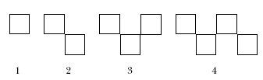
Graphic Organizers
Consider the following middle grades math problem from a recent state assessment.
How many vertices (corners) are there in 1, 2, 3, 4, 5, 6 … n squares when they are arranged in the following way
Ho,,.,.<./,/w many vertim,vces (corners) are there in 1, 2, 3, 4, 5, 6 … n squares when they are arranged in
How many vertices (corners) are there in 1, 2, 3, 4, 5, 6 … n squares when they are arranged in the following way?
Notes:
Consider this question. (question and diagram from http://www.amle.org/Publications/MiddleSchoolJournal/Articles/November2009/Article4/tabid/2083/Default.aspx)
Many of us could think about a way to solve this and probably solve it quite systematically. However, for a student with dyscalculia, this problem can be completely confusing. This is where a graphic organizer could be extremely helpful. Let's see how.

Slide 23
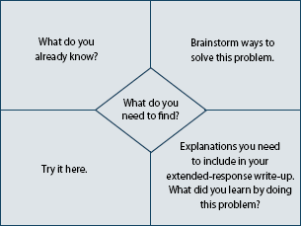
Graphic Organizers
Notes:
Hand out a blank sheet of paper to each attendee. Explain that this type of graphic organizer (from http://www.amle.org/Publications/MiddleSchoolJournal/Articles/November2009/Article4/tabid/2083/Default.aspx) is called a four corners and a diamond graphic organizer. Teach attendees how to fold their piece of paper to make this organizer (directions on website). Now, have them work either individually or with those around them to fill out their organizer as if they were using it to help them solve the problem from the previous slide. (May need to flip back to the previous slide so attendees remember what problem they are to solve.) After giving attendees ample time to fill out organizers, go to next slide for student examples.

Slide 24
Graphic Organizers
Compare your work and answers to that of some students with math disabilities who used this organizer to solve the same problem.
Student work
Graphic organizers can be very helpful!
Notes:
Click on link and scroll down on webpage to find sample of student work. Once there, click on the image of the student work to magnify it enough so the attendees can view what the students did. Hold whole group discussion about how graphic organizers can be useful for students with disabilities in math.

Slide 25
Instructional Strategies
Mnemonic Instruction
-"Mnemonic instruction is a set of strategies designed to help students improve their memory of new information." (The Access Center, 2006)
-Links new information to prior knowledge
-3 types
Notes:
Another instruction strategy you can use to help your students with math disabilities is mnemonic instruction. (Read quote from http://www.ldonline.org/article/13717/).
When you use mnemonic instruction, you are linking the new information to something the student already knows. We are going to discuss and look at examples of 3 different types of mnemonic instruction.

Slide 26
Mnemonic Instruction
Keyword
-"A keyword is a familiar word that sounds similar to the word or idea being taught. Keywords are generally used with an illustration of some type." (The Access Center, 2006)
-2x2=4 (skateboard with 2 sets of 2 wheels)
-2x3=6 (6 pack of pop)
-2x4=8 (spider with 2 sets of 4 legs
Notes:
(Read quote from http://www.ldonline.org/article/13717/) Here is an example of how a keyword can be used in math instruction.

Slide 27
Mnemonic Instruction
Pegword
- "Pegwords refer to a set of rhyming words that are used to represent numbers." (The Access Center, 2006)
-Students have to be taught which pegwords are associated with which math words before this strategy can be used effectively. For example, after students learn that "sticks" represents "six", you can teach them "sticks times sticks equals dirty sticks" (6x6=36)
Notes:
(Read quote from http://www.ldonline.org/article/13717/) Here is an example of how the pegword method can be used in math.

Slide 28
Mnemonic Instruction
Letter
-"Letter strategies include acronyms and acrostics (or sentence mnemonics)." (The Access Center, 2006)
-PEMDAS (order of operations)
Parentheses, Exponents, Multiply/Divide, Add/Subtract
Notes:
(Read quote from http://www.ldonline.org/article/13717/). Let's look at an example of the letter strategy.

Slide 29
Mnemonic Instruction Possibilities
-Take a look through your curriculum material that you brought with you.
-Any areas or concepts you could use mnemonic instruction with?
-Volunteers?
#mnemonicideas
Notes:
Encourage volunteers to share ways they could use mnemonic strategies with their current curriculum and textbooks.

Slide 30
Homework
-Choose one for more research:
-Foldables
-Effective questioning
-Effective problem solving skills
-Coding
Notes:
Due to time constraints, there are several more incredible instructional strategies that can be used in math that we are not able to cover in this session. We ask that each of you please choose one topic to do some research on tonight. Bring back your notes, and we will review them as a whole group in the morning. Dig deep, there is a lot of information out there!

Slide 31
Response to Intervention (RTI) Objectives
Objectives:
Attendees will be able to define RTI and describe the different tiers and their purposes.
Attendees will be able to navigate the EasyCBM program in order to retrieve probes and record data.
Notes:
We are going to switch gears now and go onto our next topic of the day:Response to Intervention, or RTI. Here are our objectives for this session.

Slide 32
Response to Intervention (RTI)
-"Response to Intervention (RTI) is a multi-tiered approach to help struggling learners. Students' progress is closely monitored at each stage of intervention to determine the need for further research-based instruction and/or intervention in general education, in special education, or both." (RTI Action Network)
Notes:
(Read quote from http://www.rtinetwork.org/learn/what).

Slide 33
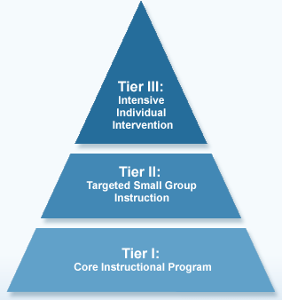
Response to Intervention
Notes:
All students are screened in the RTI process and are then placed in one of three tiers. Tier 1 is where most students are placed. These students are performing at grade level and the core instructional program they are currently in will suffice. Some students will be labeled as Tier 2 students which means they will benefit from small group instruction because the instruction they are getting in the core program doesn't seem to be enough. The smallest percentage of students will fall in the Tier 3 group and these are students who are well below grade level. They require intensive individual intervention. Now, what does all of this mean in the math classroom?

Slide 34
RTI and Math
Who needs mathematics intervention?
-Universal screening tools
-Whole class
-Curriculum-based measurement probes
-EasyCBM
Notes:
The first step in using RTI in the math setting is figuring out who needs math intervention. In order to do this, a universal screening tool must be used. This tool is used with the whole class, because every student needs to be placed in one of the three tiers. Once type of tool that is used widely is curriculum-based measurement (CBM) probes. These are quite popular because they can be administered to an entire class in just a couple of minutes, and they provide accurate placement data.
We want to show you an example of a CBM probe you may want to use in your own classroom. (Log onto EasyCBM using presenter password and walk teachers through each of the steps for how to pull up a probe and then what to do with the data once all of the students complete the probe. Give attendees a copy of their grade level probe sample as well.)

Slide 35
EasyCBM
-Your turn!
-Absolutely free
-Computer lab
-What did you think?
#EasyCBM
Notes:
Now that you have been introduced to EasyCBM, and because EasyCBM is a free resource, we want to give you a chance to explore it on your own. Let's head to the computer lab. (Attendees will go to the lab, create a login and password for EasyCBM and play around with all of the features. They will be encouraged to enter fake data, turn that data into charts and graphs, and explore the different math probes available. Attendees may also start adding students to the program if they would like to.)
(When attendees have had ample time in the lab, they will regroup in the meeting room. Presenters will then begin a reflection discussion. They will ask for volunteers to tell the group what they liked and maybe what they didn't like about the EasyCBM.)

Slide 36
RTI and Math
What type of intervention is needed?
-25-50% = Tier 1
-2-4 students per class = Tier 2
-1 student per class = Tier 3
Notes:
After the universal screening has taken place, the next task is to decide what type of intervention is need. Areas in the CBM probe that a large group of students (25-50%) struggled with will need to be what is called a Tier 1 intervention. This means that ALL students will receive instruction on those topics. When there are areas of the probe that 2-4 students per class had difficulty with, those will be Tier 2 interventions and those students who struggled will have their needs met in small group instruction. When 1 student on average per class has a hard time with an area of the probe, that student will be placed in Tier 3 and provided an individualized intervention. Students who do not respond to the instruction they receive in either Tier 1 or Tier 2 may also move to Tier 3 for more individualized instruction.

Slide 37
RTI and Math
Is the intervention working?
-Yes? Intervention stays the same
-No? Change must occur
Notes:
After universal screening and placement have been completed, interventions will take place. During the intervention phase, it is important to find out if the intervention is working. This is done through constant progress monitoring. If the teacher leading the intervention notices a student is not improving, or improving very little, he or she will decide what needs to be done. If the non-progressing student is in Tier 3, his or her plan must be changed because the current is not benefitting the student. If the non-progressing student is in Tier 1 or Tier 2, he or she may need to move to a lower tier to receive more intensive intervention.

Slide 38
Gifted Learners Objectives
Objectives:
Attendees will understand the definition of gifted learners.
Attendees will learn the basics of the Javits Act and the implications it has on the education of gifted and talented students.
Attendees will demonstrate their knowledge of gifted learner instruction through role play.
Notes:
For our last session of the day, we want to switch the focus over to our gifted learners. The objectives for the gifted learners session are...

Slide 39
Gifted Learners
"The term gifted and talented student means children and youths who "The term gifted and talented student means children and youth who give evidence of higher performance capability in such areas as intellectual, creative, artistic, or leadership capacity, or in specific academic fields, and who require services or activities not ordinarily provided by the schools in order to develop such capabilities fully." -Federal definition from the Javits Act
Notes:
(Read quote from http://www.nagc.org/WhatisGiftedness.aspx).

Slide 40
Gifted Learners- Javits Act
-Jacob Javits Gifted and Talented Student Education Act (1988)
-Support talent in U.S. schools
-Does not provide funding
-Purpose: Organize a program that will help schools meet the needs of gifted and talented students.
#JavitsAct
Notes:
The full name of the Javits Act is the Jacob Javits Gifted and Talented Student Education Act. It was passed in 1988 as part of the Elementary and Secondary Education Act to help support talent in U.S. schools. The Javits Act is the only federal program that is geared specifically toward gifted learners. However, it does not provide any funding to schools. The purpose of the act is to organize a "program of scientifically based research, demonstration projects, innovative strategies, and similar activities that build and enhance the ability of elementary and secondary schools to meet the special educational needs of gifted and talented students." (http://www.nagc.org/index.aspx?id=572)

Slide 41
Gifted Learners
-How do teachers help their gifted learners reach their fullest potential?
-Dos and don'ts of instruction for gifted learners
-Reading and role-playing activity
Notes:
So, we know what gifted learners look like, but the question is, what can we do for them when we have 29 other students in the class to teach? There is a wonderful article we have for you today that provides some dos and don'ts of instruction for gifted learners. We think it is important for you to see these because it may clear up some misconceptions you have had about teaching the gifted learner. Before the article is passed out though, it is important you understand the activity that will go along with the reading. You have been working in the same groups all day, so to switch it up, we are going to switch groups around a little. If your birthday is between January 1 and July 10, you will be in the group reading about the dos of gifted learner instruction. If your birthday is between July 11 and December 31, you will be reading about the don'ts of gifted learner instruction.
As a different means of presentation, you will be role playing each do and don't for the rest of the group with members of your small group. Role playing is a great technique that can be used in the classroom to get students involved in their learning, and that is exactly what we are going to do here today. So, the article will be passed out to you now. Please do the reading, and get with your group to decide who will be doing the role playing for each do and each don't. (Pass out article. When teams are ready, do the role playing activity and hold discussion after about what was learned.)

Slide 42
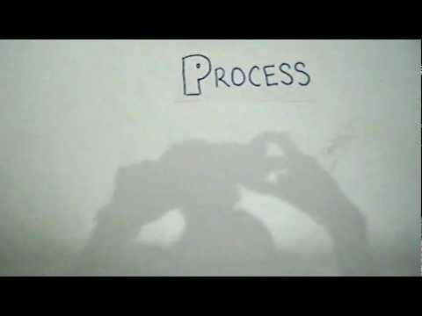
Gifted Learners
Notes:
Excellent job with the role playing! To summarize everything we covered about gifted learners, here is a short video clip.

Slide 43
End of Day 1
-Summary of the day
-Homework reminder
-Any questions?
-Day 1 Reflection/Exit survey
-See you tomorrow!!!
#day1thoughts
Notes:
Well, that wraps up our busy first day! Today we covered several different areas including differentiation, learning disabilities in math, instructional strategies, RTI, and gifted learners. Please don't forget about your homework involving looking up information about one of the instructional strategies we didn't have time for during the day. Are there any questions? Alright, before you leave, please fill out your Day 1 Reflection sheet and also grab an exit survey and take a minute to fill that out for us. We value your opinion so much. Thank you for being such a great audience and such tremendous learners. We look forward to seeing you in the morning!

Slide 44
DAY 2

Slide 45
Day Two Topics
UDL 9:00-11:00 AM
Accommodations/Modifications 11:00 -12:00 PM
Lunch Break 12:00-1:00 PM
Co-teaching 1:00-3:00 PM
Collaborative Learning 3:00-4:00 PM

Slide 46
Online access: Day 2
Reminder: please go to this website:
http://teachinginclusivemathcep842.weebly.com/
Click on the tab "Day 2" to locate information we will be discussing in our presentation today. You may also view our PowerPoint under the tab labeled "PowerPoint".
Notes:
Remind attendees to access the presentation's weebly website.

Slide 47
Tweet it!
Don't forget to tweet and tag!
questions
comments
interesting ideas
suggestions
#differentiatingmathinstruction

Slide 48
UDL objectives
Learning objectives for today's presentation:
Attendees will identify the three principles of the UDL framework.
Attendees will describe the guidelines and checkpoints within each UDL principle.
Attendees will use web-based resources and colleagues to locate math classroom activities to use for various UDL checkpoints.
Notes:
These are the learning objectives that we expect our participants to master by the end of Day 2, segment 1.

Slide 49
Universal Design for Learning
Universal Design for Learning (UDL) is a "set of principles for curriculum development that give all students equal opportunities to learn."
UDL can be a great tool to use in preparing for a math lesson targeted to meet a diverse group of students.
#UDL
Notes:
(quote from: http://www.cast.org/udl/)
This morning, we will spend a few hours learning about Universal Design for Learning. Universal Design for Learning (which we will often refer to as 'UDL') is a blueprint for educators to use in designing and implementing lessons that meet ALL students needs. This framework was designed to assist teachers in creating lessons that build in supports and challenges for all learners. In planning with UDL, educators attempt to break down barriers that would stand in the way of any students not succeeding in the classroom. Learning how to use UDL will take some time, but we feel sure that this morning's presentation will give you a better understanding of UDL, and allow you practice in using the framework in your own lessons.
*pass out UDL toolkit folders--
*remind teachers to locate the Weebly website as provided on day 1: www.
Discussion: What do you think, when you consider the words in the phrase 'Universal Design for Learning"?

Slide 50

History of Universal Design
The UDL framework comes from the Universal Design concept, originally created by an architect attempting to design buildings that all individuals could access, regardless of age or presence of a disability.
Aging in Place video:
Notes:
UDL was originally created by an architect, Ronald L. Mace, who was attempting to design housing and buildings that would be user-friendly for all people, regardless of age or presence of a disability.
This video clip (https://www.youtube.com/watch?feature=player_embedded&v=F8CaQ1417JI, 5:40) offers viewers a quick insight into how buildings were designed with all users in mind, leading educators to understand where Universal Design for Learning originated.
BEFORE THE VIDEO: Viewing prompt-- "As you watch this 6-minute video, please consider the variety of accommodations the architect, designer, and builder built into the home. Jot down the accommodations and modifications to the home, we will discuss these after the video."
AFTER THE VIDEO: Discussion question-- "Think about how much "easier" it is for architects, builders, and homeowners to plan ahead for meeting people's' needs, rather than coming back into the home after 10 years and making the changes after the need has been identified. How can this concept be true in education as well?" Participants will discuss at their tables, and share any insightful comments or questions with the large group.
information from https://en.wikipedia.org/wiki/Universal_design
video from https://www.youtube.com/watch?feature=player_embedded&v=F8CaQ1417JI

Slide 51
No more "one size fits all"!
As 21st century educators, we know that our students each have unique learning needs. We can no longer plan and implement a "one size fits all" lesson and expect our students to learn and grow!
UDL allows teachers to tailor elements of the teaching and learning process to meet students' needs.
Notes:
Our students are not all "average". In presenting a "one size fits all" lesson, we are effectively eliminating the opportunity for the majority of our students to be successful, whether they be learning disabled, or gifted, or somewhere in the "middle". Think about your classroom; I'm sure you can easily pinpoint a handful of students that are either not being supported enough or not being challenged enough by a one-size-fits-all lesson. Now, think about yourself as a learner. We know that some people learn better through use of visuals (some with words and some without), some understand more with audio or verbal explanation, and some learn best with hands-on activities. This concept applies to your students, as I'm sure you know! We are sure that you are already using differentiation in your classroom to meet the needs of your diverse learners, but we'd like to share a new idea with you... a way to plan ahead for those diverse learning needs in a way that will really benefit ALL students!

Slide 52

A sea of diverse learners...
Notes:
Look at this image. Think about the five learners you can see. Chat with your neighbor about how different each student is, and how each learner is using a different modality to learn.
Discussion questions: What do you see in this picture? Who do you see? Which students "look" like your students, and how they learn?
image source: http://www.udlcenter.org/

Slide 53

UDL at a glance...
Notes:
This video provides a simple, easy-to-understand view of the UDL. (https://www.youtube.com/watch?feature=player_embedded&v=bDvKnY0g6e4, 4:36)
BEFORE THE VIDEO: viewing prompt-- "As you watch this video, keep in mind what you learned about Universal Design from the previously viewed video; consider how UDL is similar to Universal Design. Also, think about how UDL might be at play in your classroom already."
AFTER THE VIDEO: discussion prompt-- "What are your thoughts about UDL, now that you've had a brief video introduction?"

Slide 54
UDL principles
The Universal Design for Learning framework consists of three major principles. Within each principle is three guidelines, and within each guideline, there are three to five checkpoints.
Take a look at the next slide... feel free to zoom in on your computer to read each principle, guideline, and checkpoint.
Notes:
The UDL framework is an information-dense document. At first glance, we understand that this document would be a bit overwhelmed. We completely understand if you are feeling concerned about the usability of this document. Stick with us as we unpack the UDL framework, discuss it's elements, and identify how this concept can be applied in your math lessons.
Included in your UDL toolkit folder is an "Educator Worksheet" document. This document can be used for taking notes throughout the presentation today. The document's template is located on the Weebly site, under "PD Day 2" and "UDL Toolkit".
(source of Educator Worksheet: http://www.udlcenter.org/aboutudl/udlguidelines/downloads)
In the next slides, we will discuss each UDL principle, along with the guidelines and checkpoints.

Slide 55
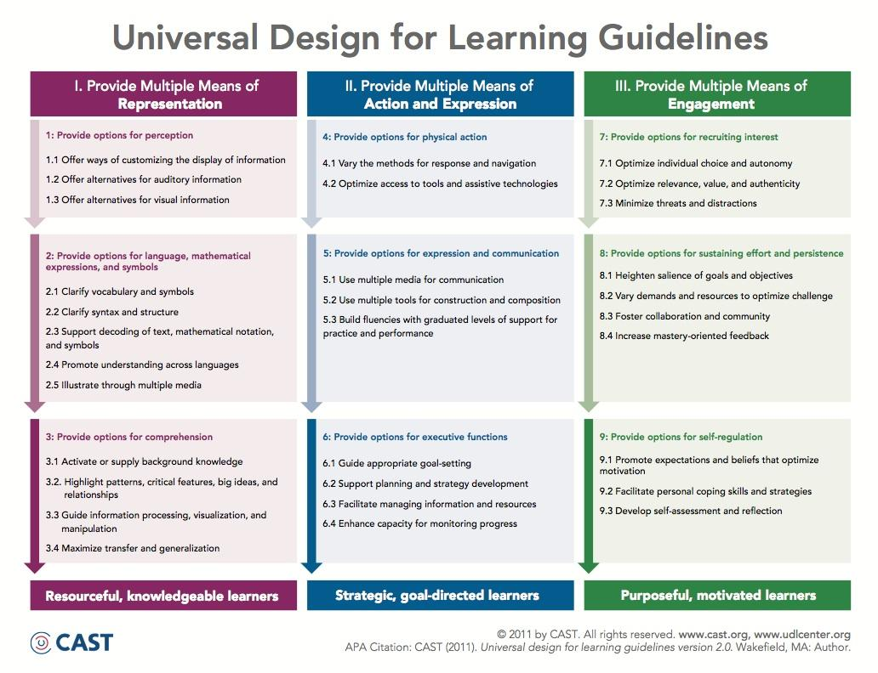
UDL Guidelines
Notes:
As we mentioned earlier, the UDL guidelines are information-dense and can be a bit overwhelming, at first glance. Lets take a look at each principle, and the guidelines within. After we review the guidelines in this image, you will view a video that will allow you to hear more explanation of how the principles and guidelines work within the UDL framework.
(Guildelines found here: http://www.udlcenter.org/aboutudl/udlguidelines/downloads, as well as PDF link to guidelines)

Slide 56
Multiple Means for Representation
What does "representation" mean?
This means you consider the various ways the information is presented to your students.
How do you vary the way you present concepts to students for the first time?
How can you vary the way you clarify or reteach information?
How can you help students to transfer information into usable knowledge?
Notes:
Please locate your UDL guidelines template to use as we discuss each principle within the UDL framework.
The first principle of the UDL framework is called "Representation". This principle asks teachers to consider how you can vary the way you present information to meet your students needs. Varying your means of representation will allow students to build networks between their prior knowledge and what you are teaching them. You must provide options for representation in order for all of your students to be successful. The Representation principle consists of three guidelines:
1. Provide Options for Perception:
Offer ways of customizing the display of information
Offer alternatives for auditory information
Offer alternatives for visual information
2. Provide options for language, mathematical expressions, and symbols:
Clarify vocabulary and symbols
Clarify syntax and structure
Support decoding text, mathematical notation and symbols
Promote understanding across languages
Illustrate through multiple media
3. Help learners develop ways to transform information into useable knowledge:
Activate or supply background knowledge
Highlight patterns, critical features, big ideas and relationships
Guide information processing, visualization and manipulation
Maximize transfer and generalization

Slide 57
Multiple Means for
Action and Expression
What does "action and expression" mean?
This is how you will consider how students will participate and/or demonstrate knowledge or skills.
How can you vary the way students respond to questions?
How can you offer assistive technology or tools to be used in expressing understanding?
Notes:
Continuing to discuss the UDL guidelines, lets move to the Guideline 2. This guideline is called "multiple means of action and expression", and means that as a teacher, you need to consider how you will vary the ways that students can participate and/or demonstrate knowledge or skills. We know that not all students can show mastery through a paper-and-pencil activity... we must give students options for how they will show us that they understand and can demonstrate usage of a taught skill. This principle consists of three guidelines:
1. Provide options for physical action:
Vary the methods for response and navigation
Optimize access to tools and assistive technologies
2. Provide learners with different ways to express what they know:
Use multiple media for communication
Use multiple tools for construction and composition
Build fluencies with graduated levels of support for practice and performance
3. Help learners develop deliberate strategies for learning:
Guide appropriate goal-setting
Support planning and strategy development
Facilitate managing information and resources
Enhance capacity for monitoring progress

Slide 58
Multiple Means of Engagement
What does "engagement" mean?
This is how you will vary the way students can engage in your lessons and stay motivated.
How can you optimize students' choices?
How can you make learning relevant?
How can you vary the demands and resources to optimize challenge?
How can you develop self-assessment and self-regulation?
Notes:
The third and final UDL guideline is titled "Multiple Means of Engagement." After learning about the previous UDL principles, what do you think "engagement" means? Think about the word-- "engagement". How do we keep kids engaged in our lessons? How can we vary the way we keep our students engaged and keep them motivated to learn?
Lets discuss the guidelines within this principle:
1. Provide options for same goal, different ways to engage student interest.
Optimize individual choice and autonomy
Optimize relevance, value and authenticity
Minimize threats and distractions
2. Help learners develop sustained attention and effort.
Heighten salience of goals and objectives
Vary demands and resources to optimize challenge
Foster collaboration and communication
Increase mastery-oriented feedback
3. Help learners develop intrinsic abilities to self regulate.
Promote expectations and beliefs that optimize motivation
Facilitate personal coping skills and strategies
Develop self-assessment and reflection

Slide 59

Unpacking the UDL guidelines
The next video will allow you to hear about the guidelines, and see how the UDL guidelines are implemented in a classroom setting.
Notes:
This video provides description of each of the 3 UDL principles, and each of the principle's 3 guidelines. This video is an opportunity for PD participants to learn about the three UDL principles. (https://www.youtube.com/watch?feature=player_embedded&v=rfsx3DGpv5o, 6:21)
The second link provides direct access to an organizer containing the UDL guidelines, with links through for each checkpoint to specific examples that teachers can use for teaching, when planning with UDL.
AFTER VIDEO: discussion prompts-- which of the UDL guidelines do you see yourself using already?

Slide 60
UDL planning template
Next you will view a template that can be used while creating a lesson, using UDL guidelines and checkpoints to drive planning.
This template is located within your UDL toolkit folder. Please locate the document and follow along as we discuss using the planning template.
#UDL
#UDL
Notes:
We will now open the UDL lesson planning checklist from the weebly website "PD day 2". The document is also located in hard copy form within the UDL toolkit folder. At this time, we will discuss the document's uses as a planning tool when creating a UDL lesson plan.
*This template is also located on the Weebly website, on "PD day 2", under "UDL toolkit".
Discussion questions: Can you see yourself using this document in the beginning stages of UDL lesson planning? Is it something you would utilize for every lesson plan? How could this document help you as you learn about UDL lesson planning?

Slide 61
Example UDL lesson plan
What does a UDL lesson plan look like?
Please find the UDL lesson plan document within your UDL toolkit. Follow along as we discuss the UDL elements within this lesson plan, and consider how your math lesson plans may be similar or different to this one.
Notes:
Participants will locate the sample UDL lesson plan in their toolkit folders (lesson plan created by group member Sarah Bowen). *Lesson plan can also be located on the "PD day 2" page of the Weebly website.
We will discuss the elements of UDL within the lesson plan, and how an educator can plan a math lesson to include UDL components that will meet the needs of diverse learners.
*Note to participants: This lesson plan was created as an assignment for a graduate-level course; it is very detailed and probably longer than what you are used to creating in your classrooms. Using UDL does NOT mean you will be required to create 6+ page lesson plans for every single lesson you plan to implement in your math classes. Later this morning, you will have the opportunity to create a rough-draft lesson plan using some UDL components; we hope this will show you that UDL lesson planning does not need to be pages and pages long!
Discussion questions:
-How is this lesson plan similar to lessons you teach in your classrooms?
-Can you think of any specific UDL guidelines that are used in this lesson plan that you have used within a similar lesson in your classroom?
-How might your future lesson plans be similar or different from this lesson plan?

Slide 62
"What is my goal?"
The main purpose of UDL is to ensure that every student is a successful learner.
As educators, we must set goals for ourselves and our students, ensuring that our lessons allow for student success at any ability level.
Notes:
As educators, we must constantly be reviewing and revising our goals for our students. To use the phrase again, these goals cannot be "one size fits all". Each student has a unique learning profile, and our instruction must allow for every student to demonstrate understanding and mastery of the skills and concepts. Your goal for one student may be to solve 20 multiplication problems in one minute, while another student only needs to solve 5, and can use manipulatives. As the second student grows, that goal will change, and the expectation will be set a little higher. Never stop revising your goals for your students. Set goals, identify UDL elements to help students work toward them, assess the mastery of the goal, and repeat the process. If a student meets a goal, set a new goal! If a student struggles to meet a goal, consider other UDL features that could better help the student meet the goal. Never stop revising goals and revisiting the UDL framework.

Slide 63
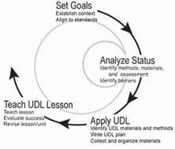
Planning with UDL
Notes:
This graphic shows the sequence of events in using UDL to plan and implement a lesson. In planning for student success, teachers must set goals that will not only fall in line with the Common Core Standards, but will also be appropriate for the student's learning needs. Next, teachers must consider what their learners will need in order to be successful. This can include differentiation in presentation of lesson content, differentiation in methods of action or expression, or differentiation in options for student engagement. Then, teachers can utilize the UDL lesson planning template and other UDL resources to design their lesson plans, and finally, teachers implement their UDL lesson plans.
Image via http://aim.cast.org/learn/historyarchive/backgroundpapers/differentiated...

Slide 64
Group activity: planning with UDL
Each group will be assigned one UDL guideline. Your group will be brainstorming possible classroom accommodations and modifications to include in your lesson plans to meet the needs of your diverse learners.
Use the UDL guidelines to investigate and identify appropriate strategies to use within your MATH lessons for your specific UDL guideline.
Make a list on your chart paper, prepare to present to your colleagues!
Notes:
Have attendees count off 1-9, and get into groups of 4-5. Each group will be assigned one UDL guideline, and will be given approximately 20 minutes to discuss their guideline and it's checkpoints, and make a list of possible classroom activities and teaching strategies that could be planned into a UDL lesson plan. The list will be written on chart paper, and each group will need a bucket of markers and a piece of chart paper. Teachers may use their computers to access the digital UDL guideline documents. The objective of this activity is for teachers to use what they've learned so far today about UDL to consider possible UDL elements to use in a math lesson.
Attendees will have approximately 15 minutes to work in groups, and then another 20 minutes to present to their peers.

Slide 65
Accommodations & Modifications objectives
Learning objectives for the Accommodations & Modifications segment:
Attendees will define the terms "accommodation" and "modification".
Attendees will describe the differences between accommodations and modifications.
Attendees will identify 5 accommodations and 5 modifications that are already in use or could be used in their classroom math lessons.
Notes:
These are the learning objectives that we expect attendees to master by the end of Day 2, segment 2.

Slide 66
Accommodations & Modifications
Classroom teachers can provide accommodations to students who are able to demonstrate understanding with simple classroom supports in place.
Teachers can provide modifications to their instruction and assignments for students with disabilities, providing that the students' IEPs have modification listed.
Notes:
Now we will transition into discussion about accommodations and modifications. Accommodations and modifications are used in all general education classrooms on a daily basis, in all subject areas. I'm sure you know of some students in your class that greatly benefit from classroom accommodations and modifications.
Discussion questions: What do you know about accommodations and modifications? Do you have any students that require specific accommodations or modifications, as instructed by their IEPs? Do you have any students that you think would benefit from accommodations and modifications in your classroom? How do you consider accommodations and modifications to be a component of UDL? How are they different from what you can provide within the UDL framework of planning and implementing math lessons?

Slide 67
Accommodations
"Accommodations are instructional or test adaptations. They allow the student to demonstrate what he or she knows without fundamentally changing the target skill that’s being taught in the classroom or measured in testing situations. Accommodations do not reduce learning or performance expectations that we might hold for students. More specifically, they change the manner or setting in which information is presented or the manner in which students respond. But they do not change the target skill or the testing construct."
Notes:
Accommodations are used daily in all classrooms. I will read the quote to you. *Read quote aloud.* I want you to think about the word "accommodate" and discuss with your group.
Accommodating our students allows for them to show what they're learning, but in a different way, compared to their average peers. We often consider this to be "leveling the playing field". We are not changing the concept or skill that we expect the student to master; instead we are changing the way the student demonstrates understanding. We may also change the way we present material, or consider the way the classroom environment might impact the student's ability to participate. Think about how this is related to the UDL concept that we spent the first part of our morning discussing; how are is the Universal Design for Learning related to classroom accommodations?
quote by Lindy Crawford, from website: http://www.ncld.org/students-disabilities/accommodations-education/accommodations-vs-modifications-whats-difference.

Slide 68
How can you accommodate your learners?
There are various aspects to consider when implementing classroom accommodations...
pacing
environment
instruction
assignments
assessment
Notes:
There are so many ways that teachers can accommodate for their differing learners. Today, we will break the types of accommodations into 5 groups: pacing, environment, instruction, assignments, and assessment. Each subgroup of accommodations contains many, many options for meeting your learners' needs. We will now break into smaller groups to identify and discuss possible methods of accommodating your students' learning. Please remember, we are ONLY talking about accommodations; we are not discussing modifications at this time.
(From: http://www.a2huron.org/huron.teachers_lounge/classroom_accommodations)

Slide 69
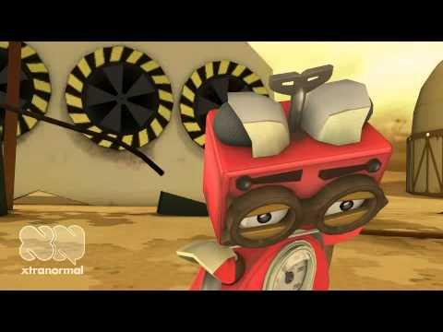
Accommodations
Classroom accommodations aren't "cheating"! They can be used for ANY student.
Notes:
Show video, and discuss students advocating for their own needs. Discuss the idea of accommodations as "cheating", and consider how accommodations can be used without being very "visible" to the other students. Consider how students that are using accommodations will feel... will they feel 'different' or the target of bullying?
BEFORE VIDEO: prompt- Watch for the accommodations that are discussed in the video, and consider whether they may or may not be appropriate in your setting. Also, consider how the student FEELS during the video...
AFTER VIDEO: discussion question- What accommodations did the teacher offer to provide? What category do they fall under, based on the previous slide? (pacing, environment, instruction, assignments, assessment)
(video: http://www.youtube.com/watch?v=tI6Cgx2GklY, 1:40)

Slide 70
Group activity
Each group will be assigned one type of classroom accommodation to research and present on.
Use your colleague's experiences and expertise, the internet, and any other available resources to make a list of at least 10 possible math-specific accommodations for your assigned area.
Write on chart paper, be prepared to briefly present to your colleagues in approximately 10 minutes.
Notes:
-Teachers will break into groups of 4.
-Each group will be assigned one of the previously presented "types" of classroom accommodations: pacing, environment, instruction, assignments, assessment. Two groups will be assigned to each type of accommodation.
-In small groups, teachers will discuss their experiences with their assigned accommodation subgroup, and will brainstorm possible classroom activities and teacher strategies that could be used within their accommodation subgroup.
-Teachers can use each other's experiences, their computers, and any other available resources to make a list of at least 10 possible accommodations for their assigned area.
-The accommodations will be listed on chart paper, and presented to the whole group.
-REMINDER: teachers should be locating accommodations that would be appropriate to use in a 4th-6th grade math classroom. Some accommodations are specific to the subject area!

Slide 71
Discussion questions...
What are some very common accommodations that you discussed?
What are some less common accommodations?
How can you be sure accommodations are used on a consistent basis?
Why is it important for accommodations to be used consistently?
Which accommodations would work in a math class? Which would not?
Notes:
Pose the following discussion questions once attendees have shared their lists of accommodations. Discuss common vs. uncommon accommodations, and how to be sure accommodations are used consistently. Consider WHO implements accommodations-- is it always the general education teacher? Do you ever have special educators in your classrooms, assisting with instruction and accommodations? (Sneak peek into this afternoon's segment!)

Slide 72
Modifications
Modifications are instructional or test adaptations that allow the student to demonstrate what he knows or can do, but they also reduce the target skill in some way.
Typical modifications include:
reducing the number of items required
reducing the complexity of the task required
Notes:
Now, we will discuss modifications. Modifications are instructional or test adaptations that allow the student to demonstrate what he or she can do, but they also reduce the target skill in some way. There is a significant difference between accommodations and modifications-- who can verbalize this difference?
Modifications cannot be used for every student. Typically, a student must have an IEP in place that will allow for classroom and testing modifications. A student must be identified as having a disability that impacts their ability to meet a learning or functional goal, and requires the instruction or assessment be modified in some way.
Discussion questions: Can you modify within the UDL framework? Why or why not?

Slide 73
Accommodation or Modification?
With a partner, read and discuss the document titled "Classroom Accommodations and Modifications for Students with Learning Disabilities", located in your "Accommodations and Modifications" tool kit folder.
Determine whether each item is an accommodation, or a modification, and mark with "A" or "M", accordingly. Be prepared to share your answer, and explain your reasoning!
Notes:
Give each pair of teachers approximately 10 minutes to discuss the list of accommodations and modifications. Teachers must label each item with "A" for accommodation, or "M" for modification. Teachers will discuss how the item impacts the student, and what the teacher must do to provide the accommodation or modification. This activity is used as an assessment tool for attendees-- pairs will be called on to discuss their answers for various items from the list, and will have to justify their reasoning.
Final discussion question- how can any of these items be used specifically within a math classroom? How can you provide modifications to math lessons, activities, assignments, or assessments? Who would you be providing these modifications to?
(list of accommodations and modifications resource: http://www.mpsaz.org/falconhill/staff/kaczekanski/teachers/files/classroom_modifications_and_accommodations_for_students_with_learning_disabilities.pdf)

Slide 74
Wrap up and review
UDL
Accommodations
Modifications
Any questions?
?
Notes:
This morning, we spent a few hours learning about and discussing Universal Design for Learning, Accommodations, and Modifications. All of these ideas are appropriate for you to take back to your math classrooms to use on a daily basis. As you learn more about utilizing Universal Design for Learning in your lesson planning, it will become more comfortable and natural to plan with UDL.
Wrap-up discussion questions/prompts:
-Someone tell us what UDL stands for.
-Please tell us why UDL is so important in lesson planning.
-What does "accomodation" mean?
-What does "modification" mean?
-What is the big difference in accommodations and modifications?

Slide 75
Day Two
Lunch break!
See you at 1:00 pm.

Slide 76
Co-teaching Objectives:
Attendees will be able to define co-teaching and describe the three characteristics which make up co-teaching.
Attendees will understand the six different co-teaching models and when to best implement each model in their classroom.
Attendees will construct a co-teaching math lesson plan and demonstrate their understanding of the pros and cons of the co-teaching process.
#coteaching
Notes:
This afternoon we are going to discuss co-teaching and how to implement this method within your classroom when reaching the needs of all learners. The following objects today will be:*read slide*

Slide 77
Characteristics of Co-teaching
Two (or more) certified teachers delivering instruction to a diverse group of students within the general education setting.
Three characteristics:
Co-planning
Co-instructing
Co-assessing
Notes:
*read definition of co-teaching* There are three main characteristics of co-teaching which we will be reviewing today. In order to have a successful co-teaching experience, the two teachers must be able to co-plan, co-instruct, and co-assess with one another. We will discuss the importance of these characteristics more in depth during our session.

Slide 78
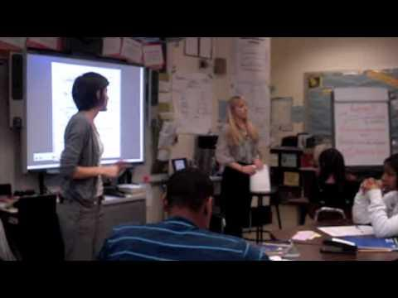
Successful Co-teaching: Keys to Team Development
Notes:
There are many positive/negative sides to co-teaching which we are going to discuss today! If done correctly, co-teaching can be extremely beneficial for all students with and without disabilities. We are going to watch a video example of inclusion and how to develop successful team development. After video one (6:20): The demands put on special education teachers today often make it hard to implement inclusion practices in particular schools. We are going to dive into this topic more in depth later. The video mentioned the "demands on compliance, other classrooms, IEP meetings" can make co-teaching difficult. Has anyone in the audience ever experienced these demands? If so, how did you deal with these challenges?

Slide 79

Successful Co-teaching: Keys to Team Development
Notes:
(10:12 minutes) Near the end of the video , one student mentioned how there is "one lead teacher and the only teacher stands in the background but in this class it seems both teachers put forth the same amount of effort" Do you agree? Disagree? Why? What are the benefits of two teachers being viewed as putting forth the same effort by the students?

Slide 80
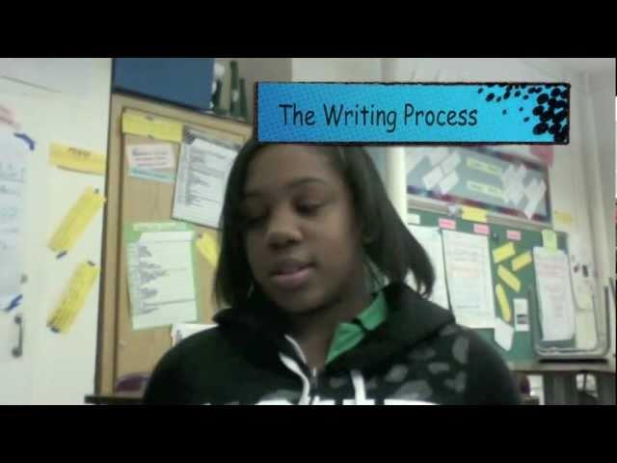
Successful Co-teaching: Keys to Team Development
#Bruce Tuckman
Notes:
video 3 (9:37). There were four stages the co-teachers followed for successful co-teaching This team-development model was created by Bruce Tuckman. The four stages are: forming, storming, norming and performing. The teachers were able to shape and guide co-teaching relationship by following these four stages.Coming to an agreement is key for co-teaching to work effectively.

Slide 81
One Teach, One Observe
One teacher delivers the instruction as the other teacher observes the students and collects data throughout the lesson.
After the lesson, it is important for the teachers to collaborate and discuss the students' progress
Best used in new co-teaching situations or when there is a need to observe/track students
Notes:
There are 6 different co-teaching methods which we are going to discuss today. The first method is called 'one, teach, observe'. In this method, *read slide*. For example, if there was a math student who was currently going through the tiers of RTI and being tracked for special education services in the area of math, the special education teacher could do an observation on the student as the general education teacher leads the whole group instruction. http://www.lilieonline.com/courses/inclusion/co-teaching.pdf

Slide 82
One Teach, One Assist
One teacher delivers the instruction as the other teacher rotates around the room assisting individual struggling students.
Best used when the lesson only needs one teacher to deliver instruction or when particular students will require additional support when being introduced to the lesson.
Notes:
*read slide*

Slide 83
Station Teaching
Two teachers split the material and introduce the content in small groups. The students rotate centers where each teacher is leading a center.
The centers without teachers are more independent based or a review of previously learned content.
Best used when the students require repetition, tiered instruction, or when introducing several new concepts within one lesson.
Notes:
*read slide* I'm sure all of you have implemented math centers into your instruction at some point during the year. This is a great way to use the station co-teaching method! You can tailor/tier your centers based off of your students' individual ability levels.

Slide 84
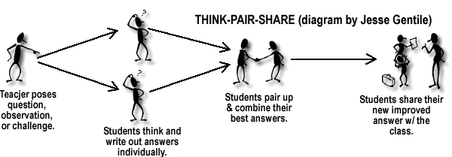
Think-Pair-Share!
Notes:
If you have done math centers in your classroom and/or station co-teaching, turn to a partner and discuss the biggest benefit/negative you have found implementing math centers into your lesson/unit and how this helped struggling learners. (let participants discuss). Okay! Let's share our answers (call on 3-4 attendees).
image from: https://www.google.com/search?q=think+pair+share&aq=f&um=1&ie=UTF-8&hl=en&tbm=isch&source=og&sa=N&tab=wi&ei=Yj53UdeJC4qs8ASFpIHADA&biw=1366&bih=600&sei=bj53UbyhNov89gTi9oCQBQ#imgrc=CG8k1ynCuv6-hM%3A%3B6mlFggG6uAkXWM%3Bhttp%253A%252F%252F120secondsofcpsd.files.wordpress.com%252F2013%252F01%252Flpthinkpair-share.gif%3Bhttp%253A%252F%252F120secondsofcpsd.wordpress.com%252F2013%252F01%252F17%252Fhave-you-tried-think-pair-square%252F%3B400%3B254

Slide 85
Parallel Teaching
Co-teachers both deliver instruction to half of the group of students in opposite sides of the classroom.
Best used when instruction would be most beneficial when delivered to a smaller group of students or for more interactive whole group discussion
#parallel teaching
Notes:
Parallel teaching is when co-teachers both deliver instruction to half of the group of students within their classroom. For example, if there was a classroom of 30 students, each teacher would take 15 students for whole group instruction. This model is best used when instruction would be most beneficial when delivered to a smaller group of students. This could also be more for more interactive whole group discussion.

Slide 86
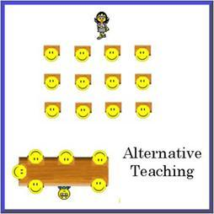
Alternative Teaching
One teacher delivers the whole group instruction as the other teacher works with a small group of students.
Best used when a group
of students require
remediation/ repetition.
Notes:
*read slide*
image from: https://www.google.com/search?q=alternative+teaching+picture&aq=f&um=1&ie=UTF-8&hl=en&tbm=isch&source=og&sa=N&tab=wi&ei=jj93Uf75G4608ASN54DQBw&biw=1366&bih=600&sei=kT93UZ3-D5Gg8QSp4ICwBg#imgrc=mWAMTiJXNcyDtM%3A%3BZUSltMXVAoUGoM%3Bhttp%253A%252F%252Fteacherweb.stcharles.k12.mo.us%252Fsped%252Fcoteaching%252Fcoteaching_files%252Fimage022.jpg%3Bhttp%253A%252F%252Fteacherweb.stcharles.k12.mo.us%252Fsped%252Fcoteaching%252Fcoteaching.htm%3B254%3B254

Slide 87
Team Teaching
Both co-teachers simultaneously share delivered instruction to a group of students. In this model, both teachers alternate instruction.
Best used when teachers have previously worked together, are comfortable with one another, and have time to plan together.
Notes:
*read slide*

Slide 88

Co-teaching ToolKit
Page: weebly> day 2> co-teaching tool kit
#coteach toolkit
Notes:
Note: Pass out 'co-teaching tool kit' folders to each participant then access the weebly website to pull up individual co-teaching forms on the projector. Review each form with the audience explaining the purpose and when it is appropriate to use each form. There are copies of each form which you can access by going to our weebly website, pulling up day two, and scrolling down to the 'co-teaching tool kit'
image from:http://cecillinois.org/service-areas/teacher-effectiveness/co-teaching-student-learning-success/

Slide 89
Co-teaching ToolKit
Lesson Plan Form
Everyday Math Lesson Plan
Lesson Plan for Stations
Best Practice Form
Planning to Plan
Co- Lesson Plan form
Co-teaching responsibilities checklist
Diagram of co-teaching models
Types of co-teaching pyramids
Notes:
Note: Pass out 'co-teaching tool kit' folders to each participant then access the weebly website to pull up individual co-teaching forms on the projector. Review each form with the audience explaining the purpose and when it is appropriate to use each form. There are copies of each form which you can access by going to our weebly website, pulling up day two, and scrolling down to the 'co-teaching tool kit'

Slide 90
Co-teaching Tool Bucket
colored acetate strips (highlight lines in text)
colored sticky arrows
large neon paper arrows to stick on board
green, yellow and red restickable dots
index cards
poker chips
dice
plastic plates for Pass the Plate brainstorming
transparency markers (water-based)
a noisemaker (bell, harmonica, clapper)
file folder work masks
clear plastic report covers (to slide over text pages)
Challenge Questions Bag
Deal or No Deal Briefcases for vocab review
Nite Lite Companion Pens
Wikki Stix
post it notes
scratch off stickers see idea explained HERE
Highlighter Tape
#tool bucket
Notes:
Depending on your school situation, several of you are pushing into multiple grade levels throughout the day. Carrying around a tool bucket filled with math manipulatives & activities can be a helpful way to always have supplies on hand and be prepared at all times throughout the day. To the left of the picture is an example of a list of items someone placed into their bucket. If you are interested in this idea, go to the following site for more information: http://www.ideasforeducators.com/1/post/2013/04/my-tool-bucket.html

Slide 91
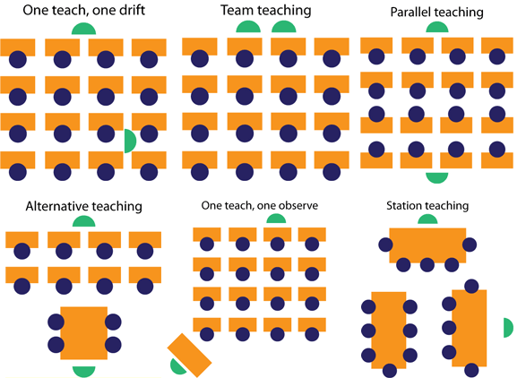
Co-Teaching
Notes:
Turn to page 8 of your co-teaching tool kit. There is a visual representation of the 6 co-teaching methods for you to use as a reference. The green ovals represent the two co-teachers and the role they serve during each co-teaching method.

Slide 92
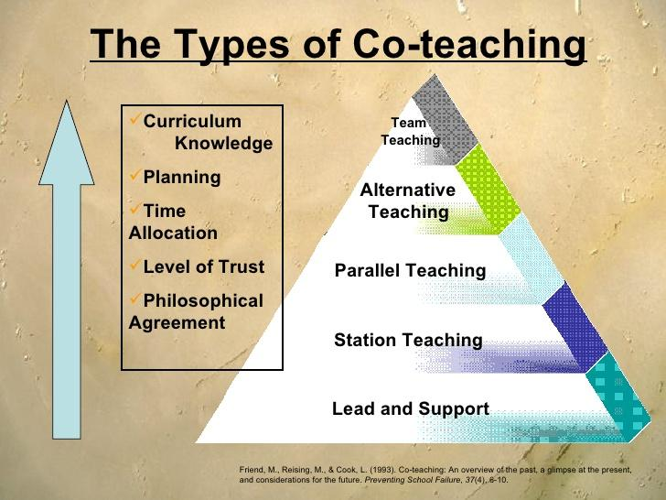
Notes:
On page 9 there is a diagram which breaks down the different types of co-teaching methods and the preparation required behind each model. As you can see from his graph, team teaching requires the most preparation. As you progress down the triangle lead and support (teach one/support) requires the least amount of planning time. This pyramid is important to keep in mind depending on your current teaching position.

Slide 93
Your Turn!
Topic:
Students will learn how to multiply two fractions together and reduce the answer to the lowest term.
Objectives:
With a visual representation, students will understand how the fraction becomes smaller when you multiply two fractions together.
Students will be able to use the standard algorithm to multiply fractions by fractions and whole numbers.
Students will be able to reduce the fraction to the lowest term by cross canceling before multiplying and finding the prime factorization of the numerator/denominator.
Notes:
We are now going to branch off into groups of two and fill out the "Murawski Co Lesson Plan Form" Projected on the smartboard, is a fourth grade math lesson. You can also pull up the objectives on your ipads. Please take the next 15 minutes to fill out the lesson plan form with your partner (co-teacher).

Slide 94
Co-teaching Tool Kit Reflection
What were the benefits to co-planning?
What challenges did you face?
Which co-teaching methods did you use and why?
Notes:
Okay! I hope you all had an easy time filling out to co-teaching lesson plan template and saw how beneficial it would be to use this form when co-planning. What were the benefits you found to co-planning this lesson together? What challenges did you face when trying to co-plan this lesson together? Which co-teaching methods did you and your partner use and why?

Slide 95
Benefits to Co-teaching/ Inclusion
"Two heads are better than one"
Teacher-to-student ratio increases
Response to Intervention (RTI)
Improvement in students' academic and social skills
Individuals with Disabilities Education Act (IDEA)
    Least Restrictive Environment (LRE)
#RTI
Notes:
Co-teaching has been found to be extremely beneficial to struggling students including: learning disabilities, attention concerns, english second language learners, and hearing impairments. A benefit to co-teaching falls under the term "two heads are better than one." When there are two teachers collaborate together they are able to come up with twice as many ideas/strategies to implement to assist struggling learners. Co-teaching allows teachers to follow RTI-Response to Intervention and respond quickly when implementing interventions. For example, when there is a group of struggling students who are not understanding long digit division, the co-teachers can follow the teach one/one assist model. The assisting teacher can then remediate the struggling learners as the other teacher continues with whole group instruction. With two teachers in the classroom, the teacher-to student ratio increases which allows the students to receive additional support. According to IDEA, students should be in their least restrictive environment. For many students with learning disabilities, their LRE is in the general education setting. When a school follows an inclusion model, the special education teacher is co-teach with the general education teacher. This allows the students with learning disabilities to be with their peers while still receiving additional support when needed.

Slide 96
The Effects of Co-Teaching in the Math Classroom
"After the first nine week period of co-teaching, 52% of the students showed an increase in their math nine week average. After the second nine week period of co-teaching the percentage of student improvement increased to 70%. In total, 16 out of 23 students improved their grades by the 4th Nine Week Grading period." (Davila)
Notes:
This quote is from a case study which measured the Effects of Co-Teaching in the Math 8 Classroom. According to the study, 16 out of the 23 students improved their grades throughout the quarter. After the co-teaching unit, the teachers had the students take a survey where they found" 60% of the students felt like co-teaching helped them to improve and 78% of the students
responded that they prefer to have two teachers in the classroom" (Davila).

Slide 97
Negatives to Co-teaching
Different classroom management beliefs
lack of collaborative planning/grading time
Personality differences
Notes:
As mentioned in the videos we watched, if two co-teachers have different classroom management/routines in an inclusion setting it can become difficult agreeing on a classroom management style. It can also be extremely difficult for teachers to coordinate schedules to co-plan and co-assess together. For example, special education teachers often have to co-teach with several teachers and grade levels throughout the school day allowing minimal planning time. When this happens, it can become very difficult to to coordinate schedules and follow all three characteristics of co-teaching. In teaching it is imperative for you to be able to communicate effectively with all communication styles. However, co-teaching can also be negative if two co-teachers have a personality clash and are unable to communicate effectively with one another.

Slide 98
Co-teaching is NOT....
One teacher and one teacher aide
When teachers rotate being in charge/delivering the instruction as the other teacher grades papers, contacts parents, writes tests, etc.
When the general education teacher grades all of their students' work and the special education teacher grades all of the IEP students' work.
Notes:
*Read slide*

Slide 99
Cooperative Learning Objectives
Attendees will be able to define the term cooperative learning and explain ways to implement cooperative learning strategies into a mathematics lesson.
Attendees will be able to work together using the jigsaw method to summarize a cooperative learning article on mathematics instruction.
Attendees will demonstrate understanding of the benefits to using cooperative learning within their classroom to facilitate their students’ learning.
Notes:
*Read slide*

Slide 100
Cooperative Learning is...
Cooperative learning is a generic term that is used to describe an instructional arrangement for teaching academic and collaborative skills to small, heterogeneous groups of students (Rich,1993; Sharan,1980).
#cooperative learning
Notes:
Definition of Cooperative Learning. *read slide*

Slide 101
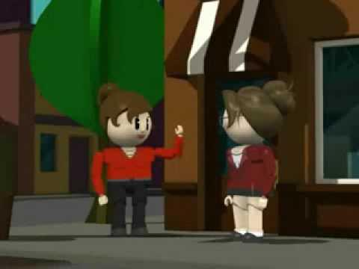
Cooperative Learning Tips
Notes:
Before we dive into cooperative learning further, we are going to watch a clip of important things to keep in mind when implementing cooperative learning strategies into your classroom

Slide 102

Group Investigation Activity
Split up into 5 groups of 8.
Assign a group leader to pick up
the following:
  Bucket of markers
  Folder
  Sheet of chart paper
Notes:
The Group Investigation is one of the cooperative learning strategies which you can implement into a classroom. It is a learning strategy where you study a topic more in depth and teach each other what they have learned. To lead into cooperative learning, you all are going to present strategies of cooperative learning to each other, which essentially in itself is a cooperative learning strategy! Everyone will need to split into groups of 8 and assign a group leader. The group leader will need to report to me and collect the following: a bucket of markers, 1 folder, and a large sheet of chart paper. In each folder there will be 8 copies of the article your group will be assigned. Typically, you would want to do this activity in your classroom with a max of 5/6 students. However, so we do not run out of time, we are going to do groups of 8 and summarize only 5 articles. You will have 20 minutes to read your assigned article and answer the following questions projected on the next slide. Go!
Image from: http://www.shapingyouth.org/safety-expert-uses-media-literacy-to-deconstruct-mcafee-study/

Slide 103
Group Investigation Activity Cont.
Based off of your article, answer the following:
What are the 3 main ideas?
How do you implement cooperative learning into a mathematics lesson (what strategies)?
What are the benefits to using cooperative learning when teaching math?
Notes:
After the groups read their articles and answer the questions, the participants will share their answers aloud with the group and discuss cooperative learning strategies.

Slide 104
How to Implement Cooperative Learning during Math Instruction
Jigsaw
Group Investigation
Student Teams
Numbered Heads
Think-Pair-Share
"What children can do together today, they can do alone tomorrow" -Let Vygotsky, 1962
Notes:
Here are several examples of ways to implement cooperative learning during math instruction. All of these examples were all covered during our group investigation activity/discussio *refer to chart paper which participants wrote on during activity.

Slide 105
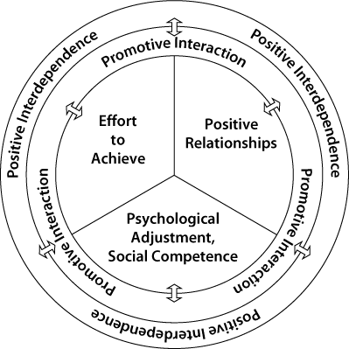
Cooperative Learning Builds Interdependence
#interdependence
Notes:
Cooperative Learning promotes interdependence! When using cooperative learning strategies in the classroom it causes peers to rely on one another when learning. *Read aloud/explain diagram

Slide 106
Benefits to Cooperative Learning Groups
Practice math skills and concepts in small groups
Builds reason and problem solving skills
Builds students' mathematical language and vocabulary
Allows students to make connections
Builds self esteem
Notes:
Read slide*

Slide 107
How to Evaluate Cooperative Learning Groups
Exit ticket for self-evaluation and peer evaluation
Grade students based on individual academic/behavior needs
Teacher observations, anecdotal notes, and checklists
Notes:
There is a variety of ways to evaluate cooperative learning groups. I am certain most of you use these assessments in your classroom without even realizing it! The first one is an 'exit ticket'. This is when the students have to write down an answer to a question or a topic they have learned before exiting the classroom. This is a great way for teachers to assess students' learning. Teachers can also grade students based on individual academic/behavior needs. For example, if one student has trouble working with peers his goal during the cooperative learning activity could be saying three respectful comments to his peers throughout the activity. The last way to evaluate cooperative learning is to have a class checklists/take anecdotal notes during the activity.

Slide 108
Homework!
Reflect on a previously taught math lesson and add the following:
  2-3 UDL Features
  1 cooperative learning strategy
Write a 1 paragraph summary explaining your rationale behind features you selected. Be sure to include how these strategies would have impacted the overall lesson.
Upload here: http://www.surveymonkey.com/s/ZD8M7WY

Slide 109
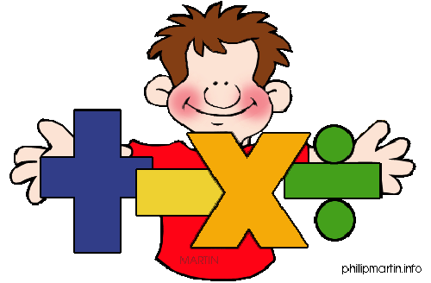
Exit Ticket
Any questions???
Please fill out our exit ticket: http://www.surveymonkey.com/s/6PVNV7F
See you tomorrow!!
Notes:
Please do not forget to fill out our online survey before leaving for the day! You can access this survey electronically by going to our weebly website, clicking on day 2, and scrolling to the bottom under the title "exit ticket". You all have been a wonderful audience today. We hope you found our presentation to be educational

Slide 110
DAY 3

Slide 111
Day Three Topics
Segment 1: Distinguishing between Assessment and Assessment Strategies (4 hours)
Lunch Break 12:00-1:00 PM
Segment 2: Using Technology to Support Differentiating (2 hour)
Segment 3: Continue Strategies for Unit Planning for Co-teachers (2 hour)

Slide 112
Online access: Day 3
Reminder: please go to this website:
http://teachinginclusivemathcep842.weebly.com/
Click on the tab "Day 3" to view our daily activities and interactive resources. You may also view our PowerPoint presentation under the tab "PowerPoint".

Slide 113
Tweet it!
Don't forget to tweet and tag!
questions
comments
interesting ideas
suggestions
#differentiatingmathinstruction

Slide 114
Day 3 Objectives and Goals Segment 1:
Assessment (all morning):
1. Attendees will be able to identify the difference between formative assessment and summative assessment.
2. Attendees will implement formative assessment strategies when planning a unit.
3. When given a math problem, attendees will be able to differentiate by tiering the math problem for diverse learners.

Slide 115
Upcoming segments:
Segment 2: Technology 1:00-1:45
1. Attendees will be able to explain how technology is used to support student performance.
2. Attendees will demonstrate technology knowledge by accessing resources with the use of an iPad.

Slide 116
Upcoming Segments:
Segment 3: Unit Planning 1:45-4:00pm
1. Attendees will demonstrate Unit Planning knowledge by following the Guiding Question Process for Planning Diagram.
2. Attendees will demonstrate knowledge of differentiating by unit planning with their co-teachers using rubrics/graphic organizers provided.
3. Attendees will receive and give feedback to peers unit planning using 3-2-1 Feedback form.

Slide 117
KWLR Sheet
What type of assessments do you use in your classroom?
How often do you assess student understanding?
What do you want to learn about assessment?

Slide 118
Day 3 Group Norms
We will be...
Respectful to ourselves and others
Active
Positive with our words and actions
Notes:
In groups of four, share what you’ve brainstormed with your group members using Timed RoudRobin sharing.

Slide 119
Timed RoundRobin
Share what you have brainstormed in groups.
1) One group member shares for time provided.
2) When leader says “switch”, then person to the right shares.
3) This is repeated until everyone has shared.
4) When all group members have shared, stand up.
Notes:
Cooperative Learning Strategy

Slide 120
Which of the following is the most true for you?
A) I persistently use both summative and formative assessment daily and frequently throughout my lessons. In addition, I use the data collected to shape my lessons for my students needs.
B) I sometimes use both summative and formative assessments daily throughout my lessons. I look at the data often, but feel pressured to keep up with the pace of the curriculum when lesson planning and do not always get to reteach.
C) I am not sure if I use summative or formative assessment techniques. I rarely find time to reteach topics.
D) My main assessments are unit tests and I would like to learn more on how to effectively use assessment to shape my instruction.

Slide 121
What is Assessment?
"Assessment is gaining insight to students' knowledge and motivation"(Ginsburg and Dolan, 2011).
What does "gaining insight" mean to you?
#assessment
Notes:
Definition of assessment is provided and participants discuss with their shoulder partners for three minutes on what "gaining insight" could mean. There is a quick group share out, then Assessment is defined further.

Slide 122
Assessment is ...
-Can be informal or formal
-Involves some kind of test
-Not limited to testing
-Contributes to effective instruction
-Identifies students strengths and weaknesses
-Helps identify difficulties
-Learn about students likes and dislikes
-Learn about students motivation
-Can predict services needed
Notes:
Did this descriptors fit into your description of assessment? Hopefully, many of them did! Ifnot, thats Ok! We are going to dig deeper into assessment and give you great strategies to improve effective instruction in your classroom.

Slide 123
Recall on barriers to math learning...
Memory Problems
Auditory Processing
Visual Processing
Motor Processing
Abstract reasoning problems
Organizational problems
Notes:
As we think about assessment, please keep learning barriers in mathematics in mind. Always reflect on how assessments can help struggling learners, and not just grade them.

Slide 124
Types of Assessment
Summative Assessment
Formative Assessment
Both: Assess student learning.
Notes:
Today we are going to focus on two types of assessment. They are summative assessment and formative assessment. Summative assessment is something we are all very familiar with. This is the assessment that is tied to student grades, school achievement and progress, and now many of our evaluations as teachers.
The second type of assessment is formative assessment. Effective formative assessment can helps our students demonstrate mastery on summative assessment.

Slide 125
Summative Assessment
Give periodically at a point in time to measure student mastery. Used AFTER learning.
State tests
Unit tests
Quizzes
ACT/SAT
Standardized Tests
Report Cards
Notes:
Summative Assessment measures students learning at a specific point in time. Summative data is helpful because it allows us to record, measure, and compare student mastery. The downfall of summative assessment is that by the time the data is collected, time has passed and it is after the point instruction can be changed to increase student skill mastery.

Slide 126
Formative Assessment
Used as a huge part of the instructional process
Not tied to grades
Seen as "practice" before the summative test
Teachers AND students act as assessors
Provides feedback for both students and teachers
During Learning
Ongoing
Notes:
That is why formative assessment is needed. Formative assessment is ongoing assessment taken "on the spot" during instruction that allows us to differentiate instruction to fit students' needs. Formative assessment is used to guide teachers on "where to go next" to ensure that students reach learning goals. Research shows that it increase student motivation to act as an assessor of their own work.

Slide 127
What is Mathematical Proficiency?
Why we need continuous assessment...
We ask "What and how ARE they learning?"

Slide 128
Computational Fluency
Number Sense
Procedural Skills
Understanding meaning and when to sue operations
Compute
Accurately
Make generalizations
Notes:
Mathematical Proficiency is critical to achieve conceptual understanding. Conceptual understanding is demonstrated by students being able to understand multiple ways to represent concepts, understand reason and solve, ability to compute accurately, ability to computer efficiently, ability to compute flexibility, knowing when to use an operation, generalize material, and self monitor results when and after solving. As you can see, all these concepts are related, and we must constantly assess student learning to help students reach computational and mathematical proficiency. Think to yourself..do your assessment accurately measure these concepts?

Slide 129
Strategies for using Effective Formative Assessments
Goal Setting
Observations
Self and Peer Assessments
Student Record Keeping
Discussion and effective questioning
One on One Conferencing
Exit Slips
Cooperative Learning Groups
Notes:
We will begin to go over strategies for effective assessment. Please take this time to refer back to your KWLR sheet to reflect on your understanding on assessment thus far.

Slide 130
Goal Setting
Clear learning targets
Each day, begin with "I can" statement
Allow students to set goals
Let's practice...
N.FL.05.04
Multiply a multi-digit number by a two-digit number; recognize and be able to
explain common computational errors such as not accounting for place value.
Notes:
http://www.amle.org/publications/webexclusive/assessment/tabid/1120/default.aspx
Learning targets and I can statements are critical for student success because for students to be successful they must understand and know the goal of each lesson daily.
Having students take part in goal setting promotes students motivation. Ask the students before lessons or units what they expect to learn. This technique increases engagement and intrinsically connects the curriculum to the student.
Let’s practice! Make this grade level content standard into an I can statement. Put in student friendly language.

Slide 131
It might look like this..
I can multiply by numbers with more than one digit.
Chorally read statement at the beginning, during, and at the end of the lesson.
Notes:
BEGIN AND END each lesson with the I can statement. This benefits all learners stay focused, but especially learners with memory deficits. Have participants share out with shoulder partners what they wrote for their I can statement.

Slide 132
Red, Yellow, and Green
RED: I NEED RETEACHING!
YELLOW: I GET SOME PARTS, BUT NEED REMINDERS WITH OTHERS!
GREEN: I'M GOOD TO GO!
Notes:
This strategy can be used on exit slips, homework assignments after being checked, in class notes, or before a unit to reflect and assess student growth. Teach this color coding to students at the beginning of the school year, and when necessary have students identify what color they are by writing the color in their paper. This can be done privately or students can hold up cards that stand for each color. Make sure that this “color coding” check in is done frequently to get students all to “green”. We do not want to identify students as a red or yellow, and pigeon hole them to that color all unit long. This strategy is beneficial to identify when and what students need reteaching.

Slide 133
Red, Yellow, Green Reflections
Unit Name | Before Unit |  |  | After Unit
I can... | Red | Yellow | Green | Red | Yellow | Green
Notes:
A rubric can be made with all the units “I can” students. Before the unit is taught, student can reflect on whether they are a green, yellow, or red. This student reflection can be done anytime throughout the unit, and then again before the unit test. This helps learners identify where they need help, what they should study, and increases intrinsic connections to the curriculum.
Examples of student reflection and goal setting sheets are shown.

Slide 134
Observations
Observing for correctness, listening for student thinking, and listening for patterns in misconceptions.
Effective observing assesses whether students understand the process and not just the procedure.
Notes:
Teachers often walkabout the room, but it is important to use this time of watching and listening to student interactions for assessment. We are just not looking for if a student is “on task”, but observing how they are solving, what their thinking is, and if they understand the process. It is effective to also carry with you notes as your circulate your classroom. Jot down patterns in student misconceptions, students’ successes, and identify if students need reteaching.
Image from:

Slide 135
Discussion and Effective Questioning
Encourage authentic and meaningful thinking
Focus on connecting to math concepts
Helps students remember important concepts
Increase Open Ended Questioning
Notes:
Effective discussion that are led from effective question increases student engagement, confidence, and mastery level. Effective Questioning allows all students to participate, promotes problem solving skills, increases math reasoning, encourages reflecting on concepts, and increases generalization skills!

Slide 136
Differentiate Questions
Preparing questions during the lesson planning process allows for scaffolding and differentiation.
Who should be able to answer this question? What questions can I ask that all students can answer, most students can answer, or only some students can answer?

Slide 137
Refer to the "Developing Mathematical Thinking with Effective Question"(PBIS TeachersLine, 2006) handout.
When and how to ask questions!
Notes:
This resource is helpful because it gives us as teachers sentence starters for asking questions. It also organizes different types of question by the goal of the question and when to use the question.

Slide 138
Jigsaw!
In groups of four you will be assigned a part of the following article. Read your part, then share out with your group on your findings.
Notes:
The article is "Constructing Complexity For Differentiated Learning"by Catherine A. Little, Sherryle Hauser, and Jeffrey Corbishley. This article focuses on tiering.

Slide 139
Apply what you've learned!
In groups of four practice creating questions that tiered and open ended (focuses on process of solving, not just the answer).
Sonal is selling cookies for a school bake sale. Write an equation for Sonal to find the money she will earn if she sells each cookie for $2.00 .
Notes:
Give each group about 15 minutes.

Slide 140
Travel and Share
One person from your group (the tallest person) will travel counter clockwise to another group to share how your differentiated this math question.
This will be done once and you have 8 minutes to share with your new group and for your new group to share with you!

Slide 141
Peer Assessments
Promotes class building and a safe learning environment for all students
Promotes student discussion
Students take responsibility for their learning
Notes:
Research shows that cooperative learning boosts achievement and students come to school to socialize with EACH OTHER. Peers naturally put mathematics in student friendly language and students will begin to see each other as resources and tools to learning. As we've talked about on previous days, grouping of students must be thoughtfully planned and organized. Before we allow students to assess and give each other feedback, we must provide them with the language to be great team members.

Slide 142
Peer Assessments
Done with Cooperative Learning Groups
Provide students with sentence starters on how to give feedback and coach peers..
"I like how you.."
"You did this ___ correct"
"Next time try this..."
"I'll give you a hint.."
"Watch how I solve.."

Slide 143
One on One Conferencing
Organize group work or stations
Set a timer (3 minutes per student)
-Student brings with them review guide
-Discuss learning, what to refer to for help, and use effective questioning
-Provide Praise
-Meet with all students
Do this before a large summative assessment
Notes:
For some reason, teachers know to use conferencing with students with written works and essays for language arts, but why not math? Spending that one on one time student allows the students to feel valued heard, gives them the opportunity to ask questions privately, and allows teachers AND students to assess their progress through conversation. This can be done by assigning stations and allow students to travel from stations and work in groups. Set a timer and call students over one on one to check in before a large tests or quiz. Start this process before students are expected to study independently. This will allow students to know what to study and you can guide them on what materials they already have handy to them to refer to.

Slide 144
Cooperative Learning Assessments 1
RoundRobin Write Around
Groups of 3-4
Pose math problem
Students pass one piece of paper solving each step one by one (taking turns solving steps)
Peers coach each other
#roundrobin
Notes:
A math problem is posed, and one students begins solving, then passes after first step, paper keeps getting passed until the problem is solved. Peers coach, praise, observe, and give each other hints. These papers can be turned in at the end of the teacher to asses student learning.

Slide 145
Cooperative Learning Assessments 2
Showdown
Groups of 4-5
Each students get whiteboard, eraser, and marker
Deck of cards with problems in middle
Students take turn leading and saying "showdown"
Notes:
Showdown: In groups (about 4-5), have a deck of cards in the middle, have on student slip cards, everyone solve on whiteboard, then card flipper says “showdown”, everyone shows their work and how they solved.

Slide 146
Exit Slips
Mini Quizzes, warm-ups, final thoughts, a question, red/yellow/green, a homework assignment.
Exit slips can be anything that is simple and quick! The yare used to do a quick check in on student learning before they leave your classroom (or you switch topics).
Remember to READ them to help lesson plan for the future.

Slide 147
Thumbs up
Quick
Visual
Can be held up high
can be held close to chest
On the spot
Allow you to immediately repeat or reteach the idea/concept

Slide 148
Let's play a game...
Number String
8 x 5
8 x 6
8 x 12
9 x 12
Notes:
Show problem one by one, ask participants to give a thumbs up close to their chest(for privacy) if they can solve, call on person with thumbs ups to explain thinking, show another problem, repeat process. This is an example of peers learning from each other as they share their thinking and notice patterns, processes being explained in peer friendly language, and assessment for the teacher.

Slide 149
Balancing Assessment
NOT EVERYTHING NEEDS A GRADE OR POINTS ASSIGNED!!
Remember what the goal of the assessment is. Is it to gauge learning? Or assess mastery?
Notes:
Grades should represent student mastery at that point in time. Do not feel overwhelmed that formative assessments need to be graded. They do not! They are there to give us information and data, not to create points for our gradebooks.

Slide 150
When to use assessment...
As you watch the next video, jot down any assessment strategies taking place between the break dancers.

Slide 151
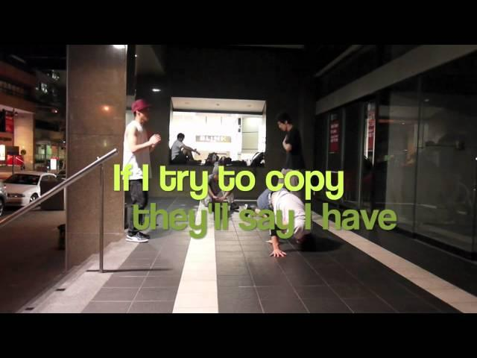
When to use assessment
Notes:
Share out what was observed.
http://www.youtube.com/watch?v=3HTbqAoeHxw

Slide 152
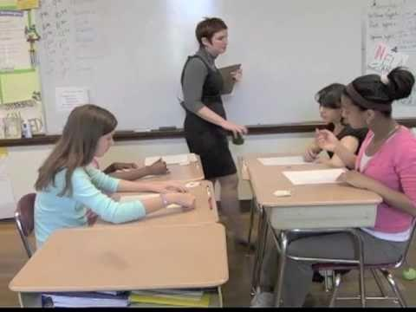
Video on Formative Assessment
Notes:
http://www.youtube.com/watch?v=rL54bfmZPzY

Slide 153
Difficulties with Assessment
Students with disabilities often do not perform as well on summative assessments.
Discussion must be held about student accommodations and accommodations per students IEPs.
Next slide will offer examples of accommodations...

Slide 154
Accommodations
Presentation: Large print, skill order on test, space for work, bold print, directions repeated/rephrased, words defined, visual supports, and audio reader.
Response: scribe/notetaker, spelling devices, graphic organizer, extended time, use of breaks, multiple testing sessions, different location, and verbal or visual prompting.

Slide 155

Co-teaching also means...
Co-Assessing!!
Assessments should be planned and reviewed by both co-teachers.

Slide 156

Before you leave...
On your sticky note, jot down an "ah-ha" moment you had about assessments and place sticky note on door before leaving.
Notes:
Recall our "I can statement". Can you effectively use assessment in your classroom? How so?

Slide 157
Lunch
Return at 1:00 pm
We will cover Segment 2: Technology and Segment 3: Unit Planning with co-teacher.

Slide 158
Day 3 Segments 2
Goals/Objectives:
Technology: 1:00-2:10
1. Attendees will be able to explain how technology is used to support student performance. 1:00-1:45
2. Attendees will demonstrate technology knowledge by accessing resources with the use of an iPad. 1:45-2:10

Slide 159
Day 3: Segment 3
Goals/Objectives
Unit Planning: 2:10-4:00
1. Attendees will demonstrate Unit Planning knowledge by following the Guiding Question Process for Planning Diagram. 2:10-2:30
2. Attendees will demonstrate knowledge of differentiating by unit planning with their co-teachers using rubrics/graphic organizers provided. 2:30-3:30
3. Attendees will receive and give feedback to peers unit planning using 3-2-1 Feedback form. 3:30-4:00
PD Closing 4:00-4:15

Slide 160
Let's Get Moving!
Ah-ha's!
When music stops, move to a chart paper and SILENTlY respond to the question!
You need something to write with!

Slide 161
Questions you're responding to...
What are barriers struggling learners face in math?
List examples of Formative Assessment:
List example of Summative Assessment:
What technology do I already use?
What are benefits of co-teaching?
What makes co-teaching hard?
What are UDL Strategies?
What is RTI?
How can I accommodate for gifted learners?

Slide 162
What Research say about Implementing Technology
The Center for Applied Research in Educational Technology (CARET), a study was done and it was found that technology can increase student performance in the following ways:
1) Improves students performance when the piece of technology being used directly supports the objective being assessed.
2) When using collaborative learning, technology increase students demonstration of skills.
3) Technology supports student need by differentiating and providing feedback to teachers and students about student performance.

Slide 163
4) Student performance is increased when technology is used everyday.
5) Technology increases student performance when students are allowed to demonstrate knowledge using technology that allows them to create and personalize projects.
6) When the entire school staff and community supports the use of technology, technology increases students’ performance levels.

Slide 164

Notes:
Watch this video and think about different technologies you use daily.
http://www.youtube.com/watch?v=rL54bfmZPzY

Slide 165
Table Top Twitter
On large piece of paper, everyone grab a different color marker and being "tweeting" technologies you use daily. No talking! You are Tweeting!
Respond to group members with ways you can use this technology in your class. If you don't know the technology, ask questions! Remember, no talking!
Notes:
This activity will take about 15 minutes.

Slide 166
Technology Resources
Go to the App Store on your Ipad
http://www.edutopia.org/blog/ipad-apps-all-content-areas-andrew-marcinek
Then, visit these websites:
wikispace.com
docs.google.com
www.iclicker.com
readaloudtechnology.com
www.neo-direct.com
Notes:
On your Ipad--Explore these resources with your co-teacher and using paper, take notes on technologies you want to use to support you in differentiating lessons. Participants will get 30 minutes to explore. People leading the PD will be walking and assisting where needed (if people have not used an ipad before). Resources are also listed on the Weebly website.

Slide 167
More Technology Resources
http://notestar.4teachers.org
https://www.khanacademy.org/
instagram.com
thesaurus.com
dictionary.com
twitter.com
brainpop.com
www.donjohnston.com
facebook.com
weebly.com

Slide 168
How ya feeling?!
You have been given A LOT of information these past three days! It is time to put it to some use!
Quick--Bathroom break for 5 minutes!

Slide 169
Unit Planning 1:45-4:00
At the end of the Professional Development you will be given time to plan an upcoming unit with your co-teacher. You will be given an hour of work time, and then be asked to share and reflect with others of different grades.

Slide 170
Why and How?
Co-teaching is not possible without co-planning!
You will get to work in the computer lab
You will be using Unit Planning Guides explained and provided for you
You will plan a unit using what you've learned about differentiation of instruction! :)

Slide 171
"Guiding Questions for Planning Accessibility Strategies"
Goals
Cautions
Identifying Potential Barriers
Planning and Implementing Accessibility Strategies
Evaluation Accessibility Strategies
* Refer to your handout as we cover these topics.
Notes:
We will cover these processes to plan our Unit.

Slide 172
Goals
How can we make sure each student is successful?
How can our curriculum become more accessible?
How to do I keep expectations high?
Notes:
As we read these questions, jot down your thoughts on how YOU can accomplish these tasks? Take notes on your adjoining handout.

Slide 173
Cautions
Watering down material
Only reaching one group of learners
Students becoming dependent on us as teachers to reach learning potential
Planning in a time efficient manner (non example: teachers feeling overwhelmed).
Notes:
Planning for differentiation is not easy. Many of us have fears that we will spend all evening after school changing instruction for all learners or a fear of watering down the curriculum. We must acknowledge these fears to avoid these pitfalls and overcome them. We must remember to be realistic with ourselves and to keep the curriculum rigorous.

Slide 174
Identifying Potential Barriers
Think about your students...
What curriculum goals do you want to accomplish?
What have students struggled with in the past?
What do I need? What do students need?
STOP- Turn to co-teacher and discuss thoughts thus far!!

Slide 175
Plan and Implement Strategies
BRAINSTORM AND LIST strategies discussed today and that you've used in the past that you'd like to implement.
(on adjoining handout)
5 minutes
Now turn to partner and discuss HOW to implement (10 minutes)

Slide 176
Evaluate
This is a reflection process. After each lesson, day, and unit, the co-teachers should stop and reflect on success and pitfalls.
Reflection and Evaluations (formative and summative) NEED to be PLANNED. Schedule times during the unit that you AND your co-teacher will: stop and reflect together, formatively assess, and summatively assess (Discuss with co-teacher 5 mins).

Slide 177
Unit Planning (1 hour)
1) Use curriculum books and materials
2) Use Unit Planning Sheet
3)Be sure to write Big Ideas and learning targets
4) Identify accommodations
5)Determine how you can differentiate to meet all diverse learning needs.

Slide 178
Visit Weebly for Unit Planning Sheets
Unit Planning Sheet
Lesson Planner Sheet
Weekly Co-Planner Sheet
Student Planner Sheet
Notes:
Teachers will move to computers labs, where they will access the Weebly website to access graphic organizers. They are not required to use all graphic organizers to plan their lesson, but whichever organizers and planning sheets that fit their need. They can print the number of forms needed in the computer labs.

Slide 179
Peer Feedback 3-2-1
3-2-1 Peer Feedback Sheet
3 things I liked:
1.
2.
3.
2 things I suggest are:
1.
2.
1 thing I wonder is :
1.
Notes:
The group will jigsaw where co-teachers will split and share with other groups members. Participants will be in groups of 5. Everyone will be separated from their co-teacher to increase the amount of units and increase amount of feedback participants are exposed to.
This can be accessed on the weebly (each participants will get 6).

Slide 180

Workshop Feedback
Using your iPad..
Please visit our Weebly to access materials from this Professional Development at .
http://teachinginclusivemathcep842.weebly.com/
On your way out, please pick up your copy of Achieving Fluency: Special Education and Mathematics by National Council of Teachers of Mathematics
Notes:
The survey monkey will assess participant satisfaction with the training. In addition, this book is another tool that identifies barriers in teaching mathematics and how to differentiate instruction.

